Slide 1
Microsoft Citizenship Programs

Slide 2
Microsoft mission as global corporate citizen
Human Rights
Responsible Sourcing
Environmental Sustainability
Integrity & Governance
Political Engagement
Our People
Notes:
In meeting our responsibilities as a global corporate citizen, Microsoft seeks to develop principled, pragmatic business approaches to challenging issues.
Human Rights: Our commitment to respect fundamental rights reflects our company mission to help people and businesses throughout the world realize their full potential.
Responsible Sourcing: We ask our suppliers to uphold the high standards of Citizenship to which we hold ourselves.
Environmental Sustainability: We seek to unlock innovative ways to reduce the environmental impact of our operations, products and services and to help others use the power of technology to address sustainability challenges.
Integrity & Governance: We are committed to growing our business in and ethical and responsible way and in compliance with applicable laws and regulatory requirements.
Political Engagement: We seek to ensure that our participation in the political process takes place in the light of day and for reasons that are clear and justifiable to our shareholders and the public.
Our People: We are proud our commitment to employees has led to Microsoft being widely cited as one of the best places to work in the world.

Slide 3
Microsoft YouthSpark Initiative

Slide 4
Goal of YouthSpark
Creating opportunities for 300 000 000 young people in 3 years in
Education
Employment
Entrepreneurship
Up to now more than
286 000 000 young people were reached

Slide 5
Empower
“Tvoy Kurs: IT4Youth” project
Hour of Code
Digital Literacy
Microsoft Virtual Academy
Internet Safety

Slide 6
Imagine
Kodu Game Lab
DreamSpark
Contest
Imagine Cup
Master of Code
CodeStars
Challenge for Change
Microsoft Student Partners

Slide 7
Realize
Imagine Cup Grants
BizSpark
Microsoft/IIDF Accelerator
Microsoft Internship
Microsoft Academy for College Hires
Microsoft Research Fellowship and Internship Programs

Slide 8
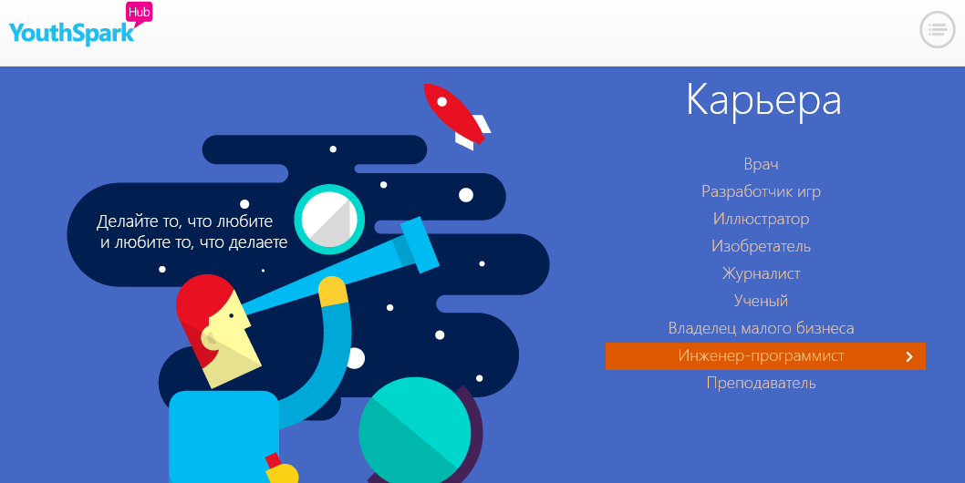
YouthSpark Info
Microsoft YouthSpark Hub (in Russian)
www.youthspark.ru
Microrayon group in VK
http://vk.com/ms4youth

Slide 9
Technology for Good

Slide 10
Why NGOs need IT?
Optimization of day-to-day work
Team collaboration online
Fundraising
Project management
Distribution of information
Notes:
Информирование – нет сайта – нет организации. Новая тенденция – нет активности в соц.сетях – нет организации.

Slide 11
IT - strategic investment
New opportunities
High efficiency and cost effectiveness
Flexibility and ease of use
Scalability and coverage
Openness and engagement
Better results

Slide 12
IT pyramid
Transformation
Optimization
Access to persistent and safe technologies
Notes:
Преобразование через инновационные ИТ
Увеличьте вклад вашей организации в решение глобальных проблем мирового сообщества, создавая ИТ-решения или разрабатывая ИТ-бизнес-модели
•ИТ - стратегические инвестиции
•ИТ напрямую задействованы в обслуживании клиентов
•Создание новых инструментов и моделей для некоммерческого сектора
Оптимизируйте процессы предоставления услуг
Увеличьте охват и масштаб вашей организации благодаря внедрению ИТ в сферу услуг
•ИТ - это двигатель для развития организации
•ПО расширяет охват и улучшает процесс предоставления услуг
•Веб-сайты и базы данных персонализируют вашу работу
•Связь и средства совместной работы улучшают координацию и процессы предоставления услуг
•Социальные сети помогают задействовать ресурсы вашего сообщества и доноров
ПОлучите доступ к стабильным и безопасным технологиям
Заложите основу для оперативной и эффективной работы с помощью ИТ
•ИТ как инфраструктура
•Основные инструменты в действии - аппаратура, программное обеспечение, сети, электронная почта и доступ в Интернет
•Политики и инструменты, обеспечивающие безопасность и надежность работы вашей организации
Начните с этого. Прочная основа позволяет использовать информационные технологии в сфере услуг.

Slide 13
Microsoft Programs for NGOs
Software grants through CyberGrants platform
Software grants through InfoDonor/ TechSoup platform
Unilateral license program
Office365 subscription discounted or free of charge
Informational support
Notes:
В общей сложности с 2001 года программой пожертвования ПО воспользовались более 800 НКО. Рыночная стоимость пожертвованного ПО – более 16 млн долларов.

Slide 14
SW grants through CyberGrants
Implemented directly by Microsoft
For NGOs meeting the eligibility criteria
For large NGOs – more than 50 workplaces
More than 100 products in catalogue; number of licenses is not limited
www.ms-ngo.ru
Notes:
Программой воспользовалось около 80 НКО

Slide 15
InfoDonor program
Implemented by TechSoup Global, national partner – Institute of Information Society
Donors:
Microsoft
iSpring Solutions
For NGOs meeting the eligibility criteria
For small and medium NGOs (less than 50 workplaces). Up to 50 licenses for 10 products
More than 100 modern Microsoft products in the catalogue
www.infodonor.ru
Notes:
Воспользовалось около 600 организаций, рыночная стоимость пожертвованного ПО – 4,5 млн долларов.

Slide 16
Unilateral license
Available till 1 January 2016 in 12 countries
Available till 1 January 2016 in 12 countries
For NGOs and small independent media
For NGOs and small independent media
Limited, non-transferable, royalty-free right to use Microsoft software products already installed on their PCs
Limited, non-transferable, royalty-free right to use Microsoft software products already installed on their PCs
Gives time to apply to the current licensing programs, including Software Donations program
Gives time to apply to the current licensing programs, including Software Donations program
http://www.microsoft.com/ru-ru/licensing/program/Corp_search.aspx#charities
http://www.microsoft.com/ru-ru/licensing/program/Corp_search.aspx#charities
Hotline:
nco@microsoft.com
+7 (964) 506-33-03
Notes:
Не собираем информацию о воспользовавшихся. Нет процедуры подачи заявок.

Slide 17
What is Office 365?
Subscription for SW allowing to optimize costs
Subscription for SW allowing to optimize costs
Flexibility and support 24/7
Flexibility and support 24/7
Expensive physical servers are not necessary
Your own domain name
5 security levels to protect your data
Business class e-mail (50 Gb for a user)
Well-known Office programs enhanced with team collaboration options
OneDrive for business - 1 Tb for a user
Internal and external sites with SharePoint
Skype for Business – instant messages, voice and video calls
Notes:
22,7 млн смартфонов в России
99,7% среднесрочной аудитории Рунета посещает соц.сети
К 2015 году 20% всех ПК будут работать в облаке
Доступен с сентября 2013 года в России
Офис365 – это всегда свежая версия Office + облачные сервисы корпоративного уровня.
Доступ с мобильных устройств.
Статус присутствия коллег.

Slide 18
What Office 365 plans are available for NGOs?
Enterprise plan Nonprofit Е1 - free of charge; Nonprofit Е3 – 225 Rub per user per month
Nonprofit Е1: e-mail, Office online versions, unlimited online meetings, file storage and sharing, intranet sites, etc.
Nonprofit Е3: nonprofit Е1+ full installed Office applications for 5 devices for each user
Plan Nonpofit Business Essentials – free of charge; Nonprofits Business Premium – 100 Rub per user per month
Nonprofit Business Essentials: up to 300 users, e-mail, Office online versions, unlimited online meetings, file storage and sharing, intranet sites, etc.
Nonprofit Business Premium: nonprofit Business Essentials+ full installed Office applications for 5 devices for each user
Notes:
Офис для 5 ПК или планшетов на Windows, а также Mac
E3 – 1000 руб. в месяц для компаний
Бизнес-премиум – 750 руб. в месяц для компаний
Скидка – 80-85%

Slide 19
How to subscribe?
Step 1. To get the free trial of plan E3 or Business Premium for 25 users http://office.microsoft.com/ru-ru/non-profit/FX104081605.aspx
Step 2. During 1 months of free trial Microsoft will check eligibility of the NGO
Step 3. In a month e-mail will come confirming or denying eligibility
Step 4. Final confirmation of eligibility by signing an agreement
Step 5. Subscribe free of charge for plan E1 or Business Essentials
Step 6. Subscribe with the discount for plan E3 or Business Premium for all or several employees

Slide 20
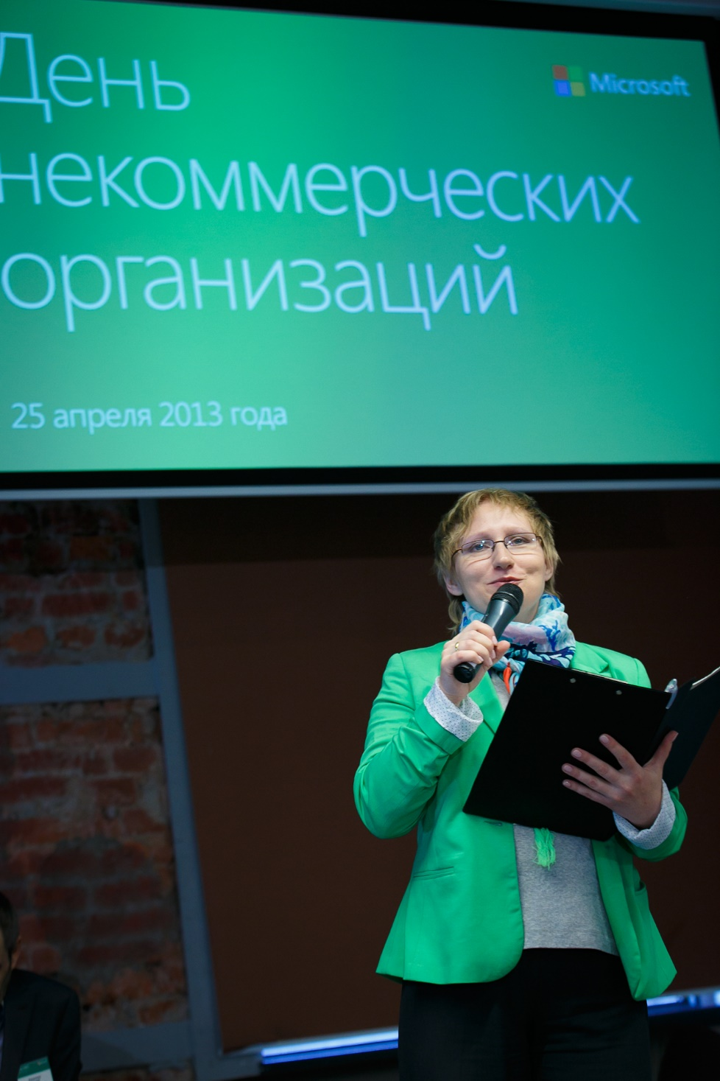
NGO Connection Days
Annually from 2009
Discussion of the IT role for NGO infrastructure development
Master-classes on modern Microsoft products and technologies
Partners: Agency of Social Information, Institute of Information Society, PH International, etc.

Slide 21
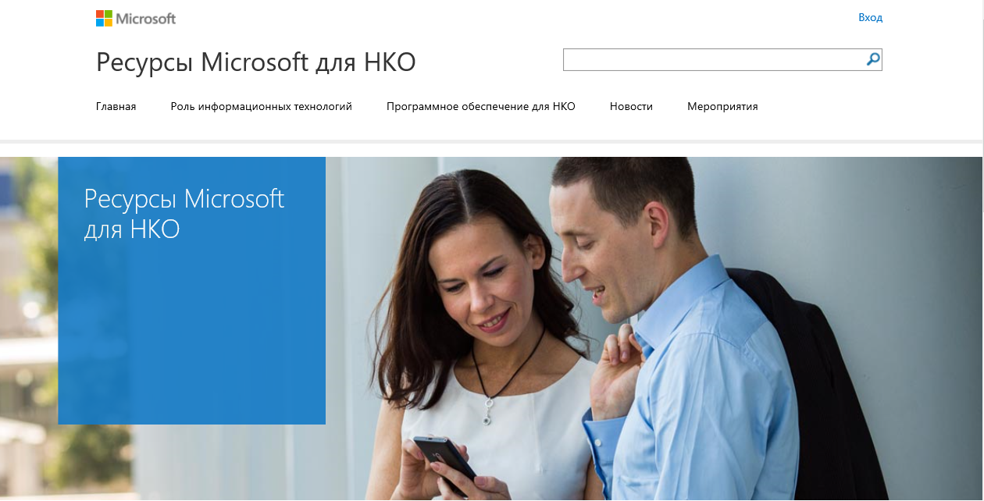
www.ms-ngo.ru

Slide 22
Контакты
Julia Sarviro
Community Affairs Manager
Microsoft Russia
i-jusarv@microsoft.com

Slide 23
Thank you!

