Slide 1
Social Innovations:
What are the Issues?
Helmut K. Anheier
May 2015

Slide 2
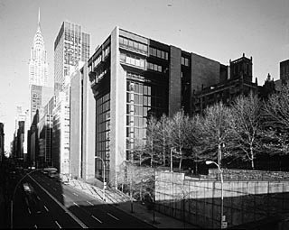
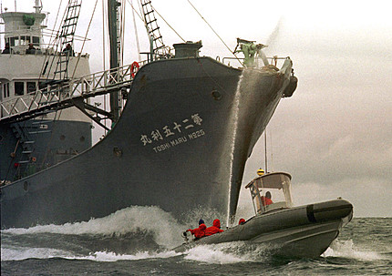
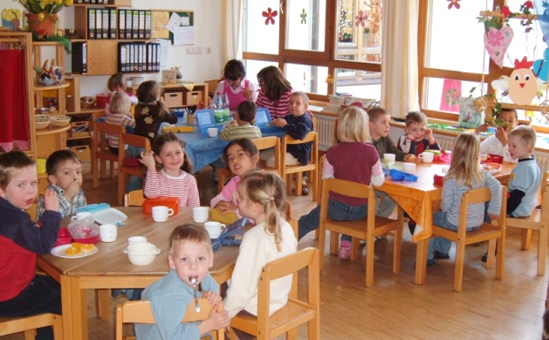
What‘s behind a Label?
Voluntary associations, like sport clubs
The Ford Foundation in New York City
Greenpeace in Action…
Day care center…

Slide 3
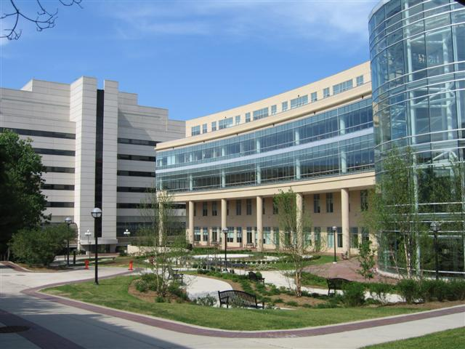
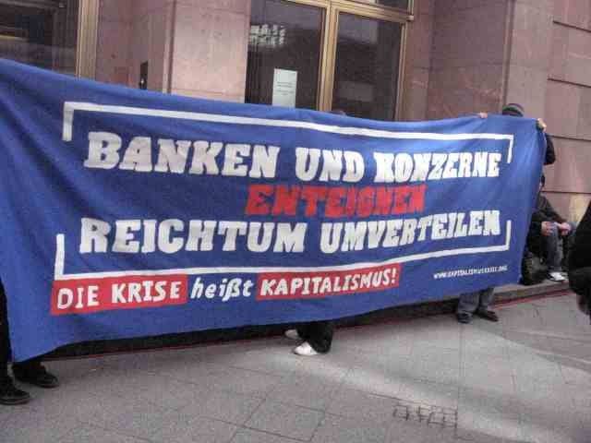
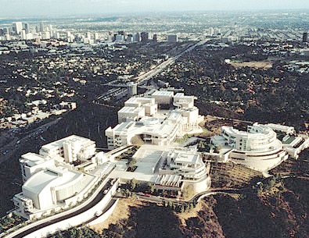
A Hospital…?
Organized protest, Occupy
Bird’s eye view of the Getty- Center, founded by G. Paul Getty, owner of the Getty Oil Company…

Slide 4
Defintions, Functions and Forms
Definition: organized, private, nonprofit-distributing, self-governing, voluntary
By "contribution" or "function" we mean the normal tasks or roles that these organization can be expected to perform:
Service Provider Role
Vanguard Role
Value Guardian Role
Advocacy Role
Or: Public-serving vs. Member-serving
Forms
Membership-based (association)
Asset based (foundation)
Liability-based (corporation)

Slide 5
Some facts
5-7% of total employment in OECD
Significant growth in economic importance of third sector, with 5% growth rates annually in some countries
Education, health, social services account for 65-70% of expenditure
Increase in associational density
Increase in number of foundations, assets
Greater policy recognition

Slide 6
Organizational Behavior and Impact
What is special about nonprofit organizations? Three major aspects:
1. Values
complex characteristics and influences of values (enabling or restraining; protecting or stifling; leading or misleading; invigorating or distracting).
2. Multiple stakeholders
managing nonprofits is managing multiple organizational components
3. Multiple revenue
→ multiple revenue streams under performance uncertainty

Slide 7
Policy Approaches
7
Notes:
7

Slide 8
Policy Approaches
Four main arguments or policy approaches (or why one should be cautious when it comes to government expectations)
New Public Management (1980s)
Neo-Tocquevillian ideas (1990s)
Social Accountability (2000s)
Social Innovation (2010s)

Slide 9
The rise of nonprofit organisations as service-providers as part of public-private partnerships and under the rubric of new public management and the rise of markets and quasi-markets in areas that have hitherto been part of the welfare state plus new needs. (NHS reform in UK, reframing subsidiarity, US welfare reform, WB – NGO relations,)
Notes:
9

Slide 10
A simple equation (No 1): less government = less ‘bureaucracy’ = more flexibility = greater incentives = greater efficiency (and perhaps greater effectiveness as well). Whatever happened to equity?
Notes:
10

Slide 11
The (re)discovery of civil society, and the growing awareness among policymakers that the very social fabric of society is changing. (Call for civic renewal at national level / Active Citizen Unit, Big Society UK; civil society commission in Germany; UN/WB/EU stress civil society, civic engagement)

Slide 12
A simple equation (No 2): more engagement = more trust = makes good citizens = makes for better economy and increases social cohesion Whatever happened to class/stratified society?
Notes:
12

Slide 13
The role of nonprofits in governance as part of a wider social accountability perspective that sees them as instruments of greater transparency, heightened accountability and improved governance of public institutions. (party system seen as inadequate; gridlock; NGOs watchdogs & whistle-blowers; participatory budgeting; WB public budgeting; TI, EITI)

Slide 14
A simple equation (No 3): citizens demand of accountability = more public accountability and transparency = better public sector performance = good economy, social self-organization Whatever happened to government / party reform?
Notes:
14

Slide 15
Social Innovation/Investment
Nonprofits are better at social innovation than governments typically are. A new form of partnership aimed at scaling up nonprofits innovations, provides for a more flexible, less inert public sector
Great Society in UK; Social Innovation Fund, US; Impact Bonds

Slide 16
no financial return
below market return
market return
Programe-related investment
Grants
Mainstream investments
Recoverable grants
Investment plus
advancing philanthropic/pecuniary purposes

Slide 17
Simple equation (no 4) Social entrepreneurship= social innovation= more effective, efficient public services, problem solving (what happened to the state as innovator?)

Slide 18
Key Policy Questions
How can nonprofit organisations be efficient providers of quasi-public goods, neo-Tocquevillian generators of social trust and accountability enforcers , and innovators-- ‘be all’ -- at one and the same time; how can they serve such functions beyond a certain threshold?
Does emphasis on one, e.g., service provision under new public management, come at the expense of the other, e.g., creating a sense of belonging and social trust, or can both be combined, and if so, how?

Slide 19
Conceptual Issues Closer look at Innovation

Slide 20
Schumpeterian Definition
E.g., Kanter (1983: 20) invention as the “generation, acceptance, and implementation of new ideas, processes, products, or services.”
innovation is a multi-faceted concept with three central dimensions: novel idea (product, service), a process leading to and triggered by it, and some outcome in terms of performance, improvement as well as follow-up innovations. There are winners and losers.

Slide 21
Normative Definition
Social innovations are new solutions (products, services, models, markets, processes etc.) that simultaneously meet a social need (more effectively than existing solutions) and lead to new or improved capabilities and relationships and better use of assets and resources. In other words, social innovations are both good for society and enhance society’s capacity to act.

Slide 22
Categorical versus Continuum
Social versus technical
Governance innovation
Need-driven versus pull of opportunities
Creative destruction potential
Zero-sum, positive sum (short to longer term)
Rationality, purposeful versus serendipity

Slide 23
Example: Hiding Hand Principle
Hirschman: if the project planners had known in advance all the difficulties and troubles that were lying in store for the project, they probably would never have touched it. But why did they?
“Creativity always comes as a surprise to us; therefore we can never count on it and we dare not believe in it until it has happened. In other words, we would not consciously engage upon tasks whose success clearly requires that creativity be forthcoming. Hence, the only way in which we can bring our creative resources fully into play is by misjudging the nature of the task, by presenting it to ourselves as more routine, simple, undemanding of genuine creativity than it will turn out to be.”
Important for: social entrepreneurship, activists

Slide 24
Hirschman´s Hiding Hand
„While we are rather willing and even eager and relieved to agree with a historian’s finding that we stumbled into the more shameful events of history, such as war, we are correspondingly unwilling to concede …that our more lofty achievements, such as economic, social or political progress, could have come about by stumbling rather than through careful planning…
Language itself conspires toward this sort of asymmetry: we fall into error, but do not usually speak of falling into truth.“

Slide 25
What Kind?
Henderson and Clark (1990) categorize technological innovations according to their internal retroactivity on organizational knowledge structures.
Products consist of components (the knowledge about which is referred to as component knowledge or second order innovations) and the linkages between them (referred to as architectural knowledge or first order inventions):
incremental -- enhancing both component and architectural knowledge;
radical -- destroying both knowledge structures;
architectural -- enhancing component knowledge while destroying architectural knowledge; and
modular -- destroying component structure while enhancing architectural knowledge.

Slide 26
WHY ? Incentives, Outcomes: private, public
Unlike innovations around private goods, the kinds of problems and issues of public goods are rarely such that they are rarely driven by incentives to maximize the utility or improve the fitness of one actor alone, be it government agencies, business corporations or civil society organizations;
it is not primarily a limited groups of shareholders but a broader, multiple set of stakeholders that benefit from governance innovations.
Bringing about such benefits through innovations requires some form of collective action among actors and across policy fields, and to so in response to signals that may be weaker and less incentive-bound than in market situations.

Slide 27
Creative Destruction?
For Schumpeter, creative destruction was part of capitalism, and indeed engine of its very dynamism. Innovations in market products lead to changes in business opportunities and practices – as mobile phones and personal computers amply demonstrate. Some corporations win, others lose; and today´s losers might be yesterdays´ winners, and vice versa.
While private good innovation can be zero-sum games for competing corporations, the great majority of consumers and the population at large can benefit and be better off.

Slide 28
Public sector innovations?
The central competitive element of markets is missing, owing to the nature of public goods, even though key players, including governments, can see competition rather than cooperation as the preferred option.
The emphasis on competition for public goods often seems ill-guided, and cooperation strategies, which can certainly contain competitive elements, are better and more beneficial to society at large.
The challenge, then, becomes to devise innovative solutions to public problems that invite cooperation towards “positive sum” policy outcomes for at least a majority of stakeholders involved.

Slide 29
Does it happen?
strong demands are put forth by politics, be it as a result elections or some legislative pressure, preferably coinciding with new leadership;
in response to publicly visible crises or failures, including internal dysfunctions not publicly visible;
new opportunities either created by new technologies (e.g., e-governance) or otherwise (e.g., EU expansion).
(Borins, 2000: 55—6)

Slide 30
Civil Society
Diversity of connections, views
Lower transaction costs
Close to grass roots, needs
Value base
Multiple revenue sources
Mobilization potential (volunteers, members)

Slide 31
We already know much…
Successful innovations typically show a distinctive set of characteristics:
uncertainty
knowledge-intensity
controversy
reaching across established boundaries
long-term commitment
ambassadors, active dissemination

Slide 32
Common themes
Beyond money, material resources
Knowledge-driven
Long-term, systemic view, multi-pronged
Involving partners, ‘networked’
Taking risks, leadership
Regular review, diverse viewpoints
Multiple strategies aimed at sustainability

Slide 33
Case | Challenge | Basic proposition | Key insight
The L3C business entity | Stabilizing coproducing hybrid organizations that seek to combine social and economic returns | Providing a forprofit form with internal nonprofit governance structure | Allow for diversity of incentives but create checks and balances to avoid goal displacement
Social impact bonds | Finding new finance mechanisms for social services | New risk allocation by creating a social investment market | Reform low-performing systems by realigning, en-forcing and adding new incentives, demanding outcome performance

Slide 34
Case | Challenge | Basic proposition | Key insight
Ushahidi | Coordinating more effectively through information management | Using citizen-based information to help message responses | Crowd-sourcing saves time and resources, and improves outcomes
mySociety | Promoting greater citizen engagement | Citizen-led creation and use of public websites | Increasing transparency on how public sector deals with „everyday problems“ reduces citizen-government gap

Slide 35
Governance Innovations
Innovations are highly context-bound and involve the interplay of individual actors, organizations and the wider institutional setting in terms of invention, process and outcome.
Innovation is more likely to happen outside centers of powers, which highlight the role of civil society and local governments as well as the self-organizing and self-regulating capacity of markets, especially when populated by small and medium scale enterprises and entrepreneurs.
First order innovations are rare, and more likely in the context of punctuated equilibriums. There is rarely a tabula rasa for new systems architecture.
Second order innovation more frequent and more likely when rigidity and inertia are lower, but they take place in an institutional and organizational setting prone to isomorphism.

Slide 36
Governance Innovations
Refunctionality and recombination are major processes for second order innovations, and often lead to interruptions and consequent changes.
Public administration systems dampen the emergence of entrepreneurs, and tend to neutralize the characteristics of innovators or intra-preneurs to encourage innovations.
There are many more inventions than innovations, and governance systems vary in the way they “pick up” innovation signals as well as in their incentives to for vetting, testing, developing and adopting innovations.

Slide 37
New Fields: Organizations
Two Dimensions
Complexity refers both to the number of elements in the organizational task environment and to their heterogeneity in terms of demands and expectations. If an organization has few task elements and all are fairly similar, such a homogeneous task environment would be less complex than a situation with many more elements that vary in their demands.
Dynamism refers to the rate and predictability of change of the elements. If the elements change rarely or slowly and are relatively predictable, then the task environment is stable; however, if they change often, fast and in unpredictable ways, then the task environment is unstable or volatile.

Slide 38
Complexity and Dynamism
High Complexity
Low Complexity
High Dynamism
High uncertainty
Mixed
Type I
Type III
Forced innovator
Open innovator/adaptor
Dynamism
Mixed
Low uncertainty
Low
Type II
Type IV
Cautious innovator/
Adaptor
Steady State Operator

