Slide 1
NGO leaders and Social Entrepreneurs: how they comply social mission and business instruments
Anastasia Moskvina
PhD in Sociology, a.moskvina@crno.ru
Centre for NGO Development, www.crno.ru
Saint Petersburg

Slide 2
NGO leaders and Social Entrepreneurs:
Practical work and Research on:
motivation and life track to the choice of entrepreneurship
how social mission could comply with business instruments
Social Entrepreneurship – business model of sustainable resolving social problem (Moskovskaya, HSE):
Social mission is more important than income
Financial sustainability’s source is mainly sails of product or service than charity donations, grants, etc. (below market return)
Innovations (social, technological, financial, etc.)

Slide 3
Actors of SE (who are they, where are they from?)
SE
Non-profits
Initiative groups, Activists
Commercial Sector
State entities

Slide 4
Practical work (Centre for NGO Development)
Brochure «Entrepreneurship activities by Non-profits”, 2014 г., articles and cases http://crno.ru/assets/files/skachat/soc_predprinimatelstvo_2014.pdf
Training course (40 hours, 36 participants) «Social Entrepreneurship for NGOs: from Idea to Business Idea”, 2014 г.
Consultancy service for NGOs on Entrepreunership: legal, accountancy details, how to find business idea, how to write business plans, etc.
Seminars on “How to become Provider of Social Services and to get reimbursement from the State”
Club of Social Entrepreneurs – coming soon
Business mentoring of social start-ups – coming soon
Etc.

Slide 5
Practical work (Centre for NGO Development)
Brochure «Entrepreneurship activities by Non-profits”, 2014 г. http://crno.ru/assets/files/skachat/soc_predprinimatelstvo_2014.pdf
Cases:

Slide 6
Charity Shop “Spasibo!”, St. Petersburg

Slide 7
Printing office “Water-melon” by NGO “Trust” employment of disabled people (social adaptation, training, organization, mentoring)

Slide 8
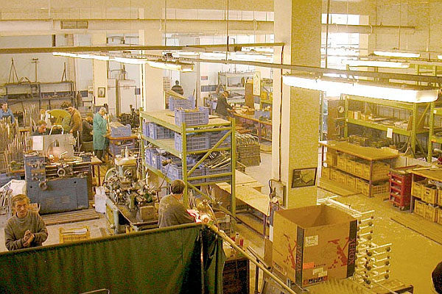
Foundation “Nadezhda (Hope)” –Factory, established by NGO Hesed Avraam
Produces technical rehabilitation facilities for disabled people
Equipment for barrier free environment for physically challenged people
Employment of disabled people

Slide 9
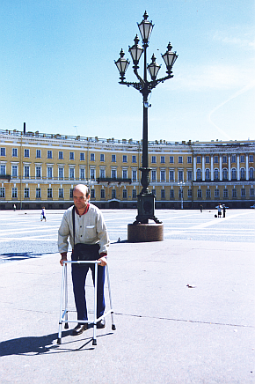
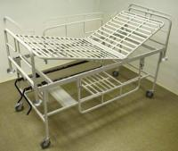
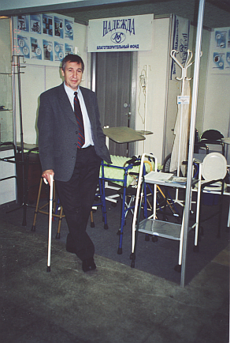
Foundation “Nadezhda (Hope)” –Factory, established by NGO Hesed AvraamЗавод «Надежда»

Slide 10
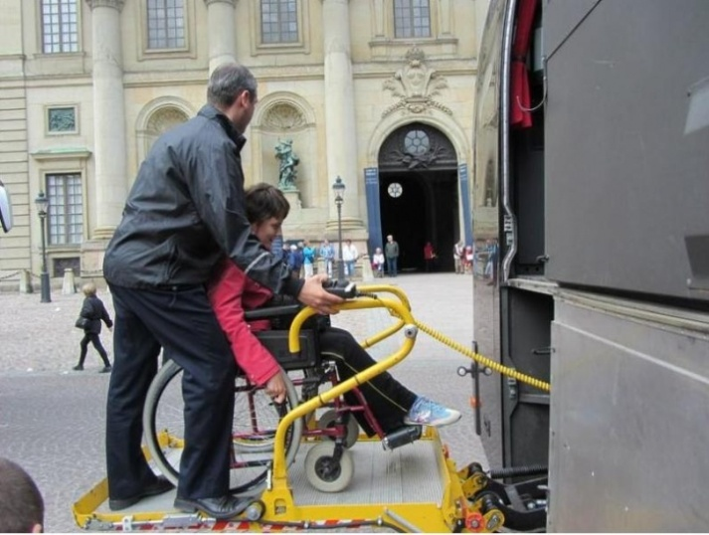
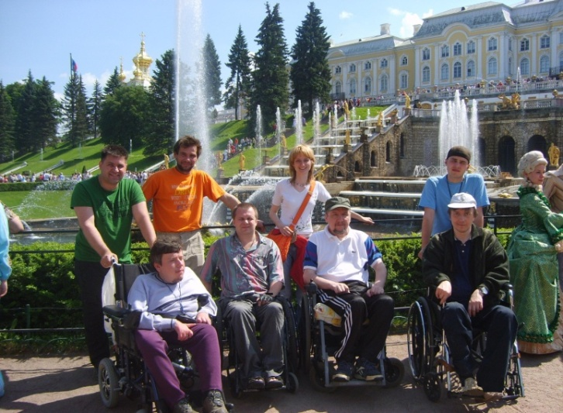
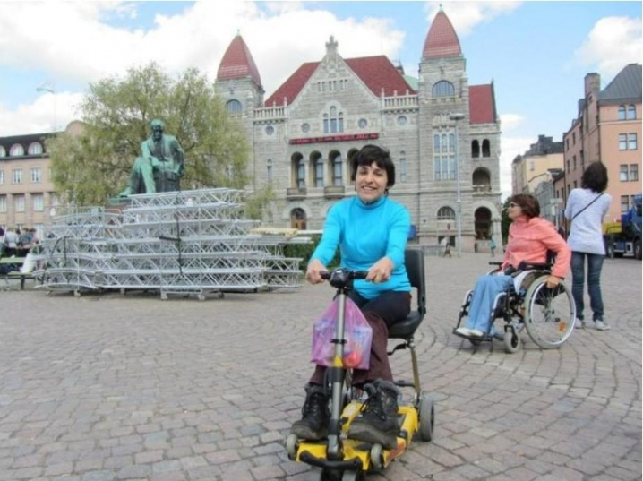
Other examples: «Liberty» Touristic Company for Disabled People
Основная бизнес-идея проекта –
организация экскурсионных туров для инвалидов – колясочников с использованием специальных транспортных средств, предназначенных для инвалидов, пандусов и пр. Коммерческой самостоятельности проект достигает за счет выручки, получаемой от приема иностранных туристов. Что позволяет предлагать российским туристам – инвалидам туры по льготным и приемлемым ценам
Saint-Petersburg
За 2009 – 2013 гг. туркомпания
«Либерти» оказала услуги
1200 туристам с ограниченными
возможностями

Slide 11
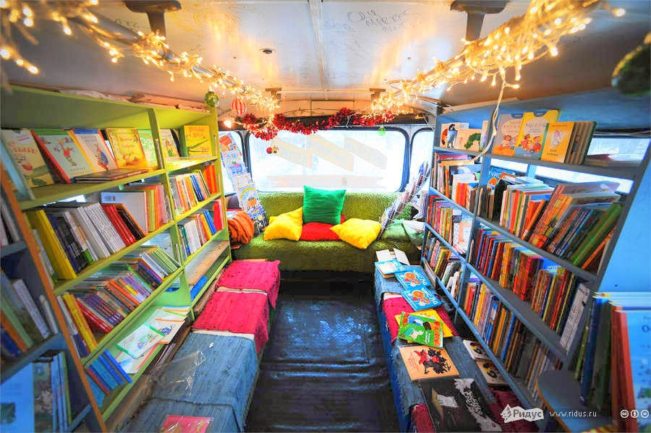
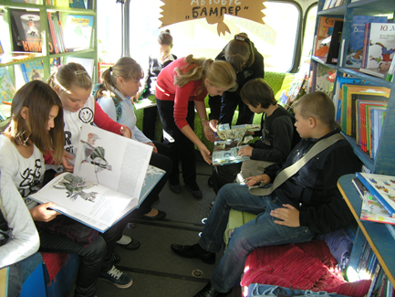
Book Bus
“Bumper, Moscow

Slide 12
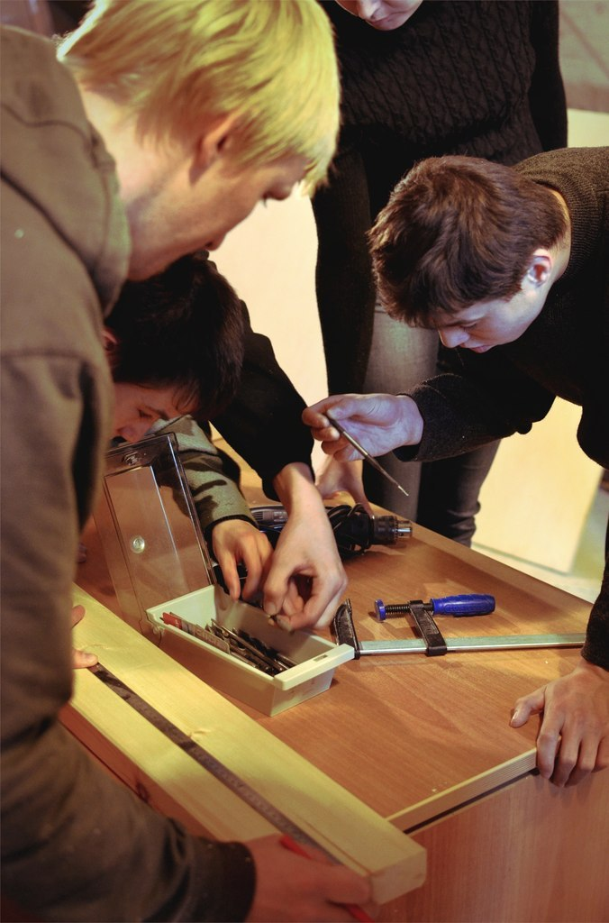
Job –I, Centre for employment of graduates from orphan homes and disabled young people
Project of Charity Foundation “Raul”, from June 2012:
Support in employment of graduates from orphan homes and disabled young people in the social responsible companies:
Packing
Retail
Building and decoration work
Services (cleaning, record-keeping)

Slide 13
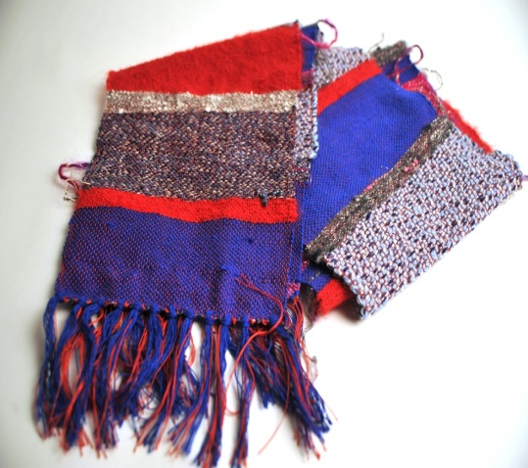
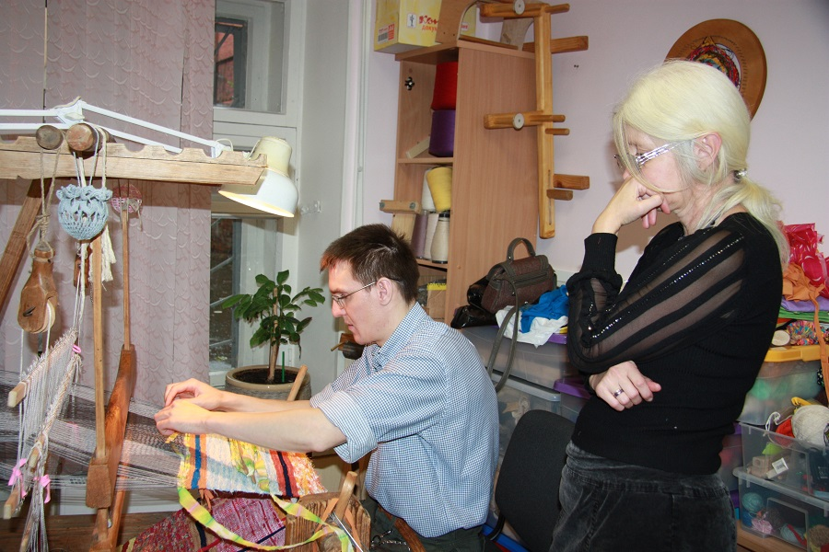
Centre “Craftsman” («МастерОК»)
Value Offer:
Employment of disabled people: organization of working places, social and professional adaption for people with mental disabilities
Products: bright creative textile and decoration items. Individual design projects. Wooden ecological toys for kids. Fashion jewelry and clothes items.

Slide 14
Practical work-2.
Training course (40 hours, 36 participants) «Social Entrepreneurship for NGOs: from Idea to Business Idea”, 2014 г.
Examples of business-ideas, elaborated by participants:

Slide 15
Art project to support therapeutic horse riding “Kind Hands“ (souvenirs)

Slide 16
Centre for acceptance of diagnosis of HIV, hepatitis
(psychotherapy services for people who has just informed about having desease)

Slide 17
Inclusive studio of dance performance and body therapy

Slide 18
Office for re-training and employment of retired people (seniors)

Slide 19
Practical work (Centre for NGO Development)
Seminars on “How to become Provider of Social Services and et reimbursement from the state”
Club of Social Entrepreneurs – coming soon
Business mentoring of social start-ups – coming soon
Etc.

Slide 20
The Problems are:
NGOs lack business prospective and knowledge and skills
NO Infrastructure for NGOs (credit loans garantees, floating capital) and they can’t use those for SMEs
Mentality – “we are for social mission, give us money to do kind things”
Risk of loosing balance between social mission and business instruments
This was proved by Research in Winter 2015

Slide 21
Research, Winter 2015 within the team of sociologists, the European University (St. Petersburg):
Analysis of SE in USA, GB:
Infrastructure (for social investments), volume, economical impact, number of employees, number of SE, types of organisations, motivation and life track of leaders, education in the sphere of SE, etc.
Motivation and life track of Social Entrepreneurs (typical models):
Concern on some social problem and desire to resolve it on a sustainable basis
Involvement in some particular situation in childhood and desire to help other people facing this problem on a sustainable basis
Businessmen: desire to create some infrastructure support and system for SE (sometimes as a new challenge or business quest)

Slide 22
Research in Winter 2015 – Part 2:
Analysis of SE in Russia:
Overview of situation, SE cases, experts, infrastructure, education, etc.
10 interviews with successful SE
Results of interviews:
Sector is not developed in Russia, just a few SE
No state support (and many SE do not want it)
Motivation – to solve some social problem

Slide 23
New research (next step). Assumptions
1. In the modern Russia NGOs should professionalize their activity with focus on using business instruments including entrepreneurship activities.
2. This could help in realization of their social mission while other instruments (fundraising) does not work as much as before.
3. Thus, NGOs could become social entrepreneurs (which gives independency and sustainability from both financial and mission points of view) which is the broadly dissiminated and efficient in foreign countries.
4. However, there are facing:
1) lack of business skills and 2) a risk to loose social mission.

Slide 24
Aim of the new research
is to illuminate and compare motivation track of social entrepreneurs and NGO leaders, who chose business instruments, as a way of financial sustainability of the social mission on the example of St. Petersburg and Leningrad Region.

Slide 25
Tasks of the research
to study and analyze typical life pathways of 1)social entrepreneurs and 2) NGO leaders who chose business instruments and realize entrepreneurship activities for resolving social problems
to hold quality research (by method of interview) of the reasons and their aims as well as motivation of their work in their organisations.
To illuminate correlation between success of social mission realization and using business instruments by social entrepreneurs and NGO leaders.

Slide 26
Duration: 2015-2016
Methods:
- interviews with NGO leaders and SE in St. Petersburg, Leningrad Region, other regions of Russia
- Comparision with EU countreis?

Slide 27
Expected results
the list of recommendations, which measures from the side of the state, foundations, NGO resource centres, other stakeholders could be done in order to develop this pro-active group as social entrepreneurs and NGO leaders who is solving social problems in our country;

Slide 28
Welcome to cooperation!
Contacts:
Anastasia Moskvina
St. Petersburg
nastya_moskvina@inbox.ru
+ 7 921 904 09 48
Skype: aymoskvina

