Slide 4
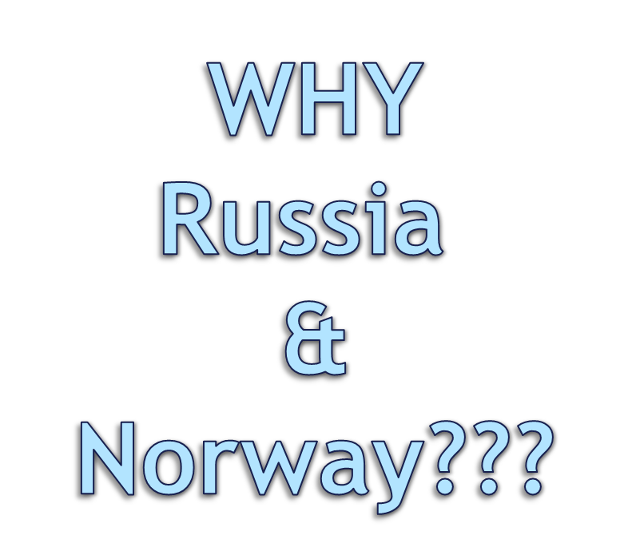

Slide 5
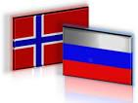
Because of:
Border
Close intercultural communication
Far North’s conditions
Different level of charitable activity: charitable culture in Norway is developed, in Russia – no (according to research of Charity Aid Foundation) http://www.cafrussia.ru/page/mirovoi_reiting_blagotvoritelnosti_1

Slide 6
Main goal:
Analysis phenomena of charitable culture in the Northern parts of Russia & Norway
+
searching answer for question “Is it possible to use Norwegian experience for Russian society??”

Slide 7
Main results:
Charity is an universal value: from ancient time it was understood as
free and not profitable aid

Slide 8
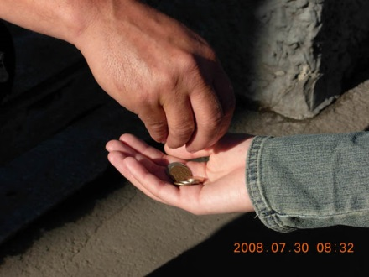
Charity always existed - people always helped each other
But organized charitable culture was different

Slide 9
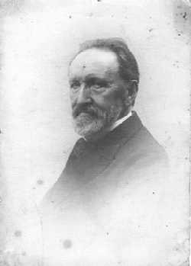
P. G. Ganzen

Slide 10
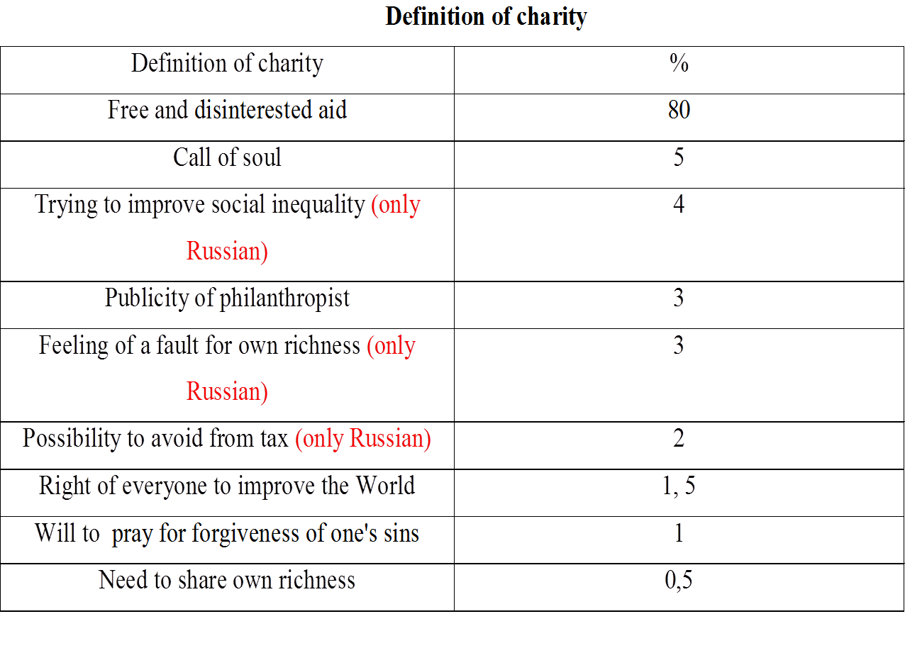
Mostly definition of charity is the same (in Russia & Norway). But you can see some difference

Slide 15
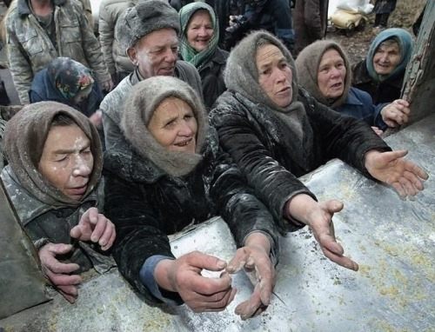
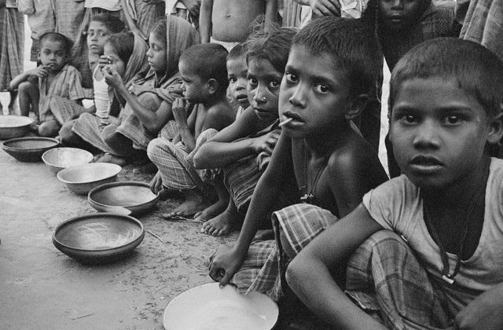
Object of charity is different in Russia & Norway
Russians mostly help people in need in Russia (shelters, homeless
people/stray animals, disabled people, etc.)
Norwegians help people in poor countries of Africa, Asia, East Europe and migrants who live in Norway

Slide 16
