Slide 1
Innovation in the Third Sector (TSI):
The Case of German Corporate Foundations

Slide 2
Current TSI Research Projects
SI-DRIVE
TRANSIT
CRESSI
SIMPACT
EFESEIIS
SEFORIS/SELUSI
THIRD SECTOR IMPACT
ITSSOIN
CITISPYCE
SOCIETY
LIPSE
IMPROVE
INNOSERV
TEPSIE
WILCO
SERVPPIN
Notes:
a „game changer“, always positive, a means to approach a problem and/or find solutions

Slide 3
Deriving the Research Need
Take a step back in TSI – explorative fieldwork
Research questions:
How do TS organizations conceptualize innovation?
How do they mobilize for innovation?
How do they implement?
Overall objectives: (1) contribute to conceptual work, (2) generate hypotheses for future research, (3) outline implications for policy-making

Slide 4
Foundations and Innovation
“They constitute an indispensable element of a liberal and solidary civil society.”
(Bundesverband Deutscher Stiftungen 2014)
Foundations as a benefactor in the social sphere, a driver of societal change and a catalyzer for innovation
(Herzog 1997; Robert Bosch Stiftung 2014)

Slide 5
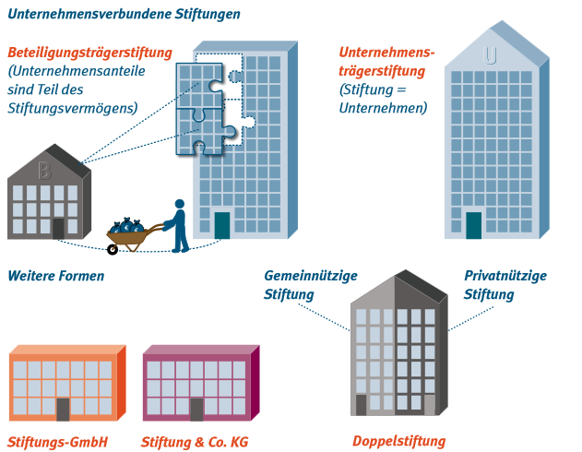
Sample: German Corporate Foundations (I)
Retrieved from StiftungsWelt 2011-1

Slide 6
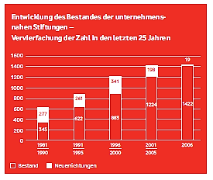
German Corporate Foundations (II)
Retrieved from
Vodafone Stiftung 2007: 17

Slide 7
German Corporate Foundations (III)
General: Foundations as distinct type of TS organizations
Peculiarities:
Independent assets for charitable purpose, infinite
Sector –Bending (Dees & Anderson 2006): social purpose but inherit market-related thinking
Large endowment – capital for experimentation
Need to create legitimacy
Stability
Conserve ideas and values of the founder
Vanguard
Potentials to move ahead and innovate
Notes:
(legally independent entity for charitable purpose, defined by assets, memberless)
(31% have €1-10mio; 15% have €10-100mio, 7% >€100mio) → less prone to market fluctuations

Slide 8
Innovation in Foundations (I)
To be researched
Ideas:
Rationale: reactive – proactive
Purpose: Strategic -- random
Motivation: Efficiency – efficacy
Capacities: In-house -- partnership/collaborative
Process: Incremental – radical
Outcomes: Products/services -- organizational processes
Level: Internal -- external

Slide 9
German Corporate Foundations (II)
Hidden assumption: When talking about innovation in German foundations in general, it is embedded within a mindset of strategic philanthropy (Porter & Kramer 1999) / catalytic philanthropy (Kramer 2009)
Relevance:
Lack of academic research on German foundations (Robert Bosch Stiftung 2014)
Gerber (2006) investigating innovation potential of the Freudenberg Stiftung
Notes:
It just don‘t HAPPEN – it may occur randomly, but there is a rationale that allows them to identify innovation at some point and try to push for it

Slide 10
Research Design
Lack of data / poor databases
2-step approach:
Rigorous literature and document review
Qualitative semi-structured interviews with >=2 organization representatives - audio-taped, coded and systematically reviewed
Interviewee sampling: most different case selection or snowball sampling
Operationalization for interview guide
?

Slide 11
Ⓒ 2015 Universal Studios

