Slide 1
Disruptive change and the Third Sector
HSE Young Experts Workshop- May 23. 2015
Niels M.V.Böhm

Slide 2
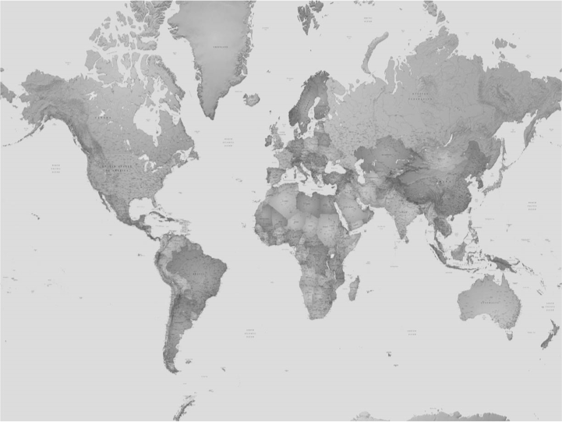
cities and Climate Change
Source: Romero-Lankao & Gnatz, 2015.
ACOES-Honduras
Konrad Adenauer Foundation—Indonesia
Programa Providencia-Brazil
Notes:
Concentrations of populations, economic activities and infrastructure create heightened risks from heatwaves, floods, sea level rise and other impacts that climate change will aggravate

Slide 3
WHAT IS DISRUPTIVE INNOVATION?
Innovation that helps create a new market and value network, and eventually disrupts an existing market and value network displacing an earlier technology
Clayton Kristensen
Notes:
Climate Action Plans are the materialization of urban climate activities
This chart shows the steep increase of climate action plans across a european sample over the past decades
According to a study by Reckien et al. from 2014, of 200 large and medium sized cities, 130 had a climate action plan.
However, practitioners and academics report that urban administrations are struggling to bring the self-imposed commitments into action. Thus, that the implementation of climate action plans reveal fundamental flaws
Why is it that?

Slide 4
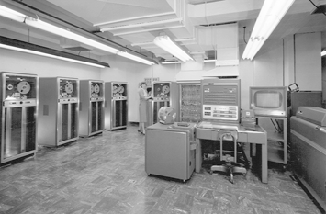
FROM THE MAINFRAME COMPUTER TO THE PC
Notes:
Climate Action Plans are the materialization of urban climate activities
This chart shows the steep increase of climate action plans across a european sample over the past decades
According to a study by Reckien et al. from 2014, of 200 large and medium sized cities, 130 had a climate action plan.
However, practitioners and academics report that urban administrations are struggling to bring the self-imposed commitments into action. Thus, that the implementation of climate action plans reveal fundamental flaws
Why is it that?

Slide 5
Trends of disruptive changeS
Geopolitical Changes and Power Shifts
Increasing importance of emerging countries (South-South cooperation)
Shrinking political space due to political interferences
Individualization
Intergenerational shift in values from materialism to post-materialism
Information and communication revolution

Slide 6
effects of disruptive change
Geopolitical Changes and Power Shifts
North-South dynamic fading away
Reduced need for North-South partnerships
Circumvention of traditional channels
Individualization
Less contributions and involvement for campaigns of established institutions
Decreasing role of intermediaries

Slide 7
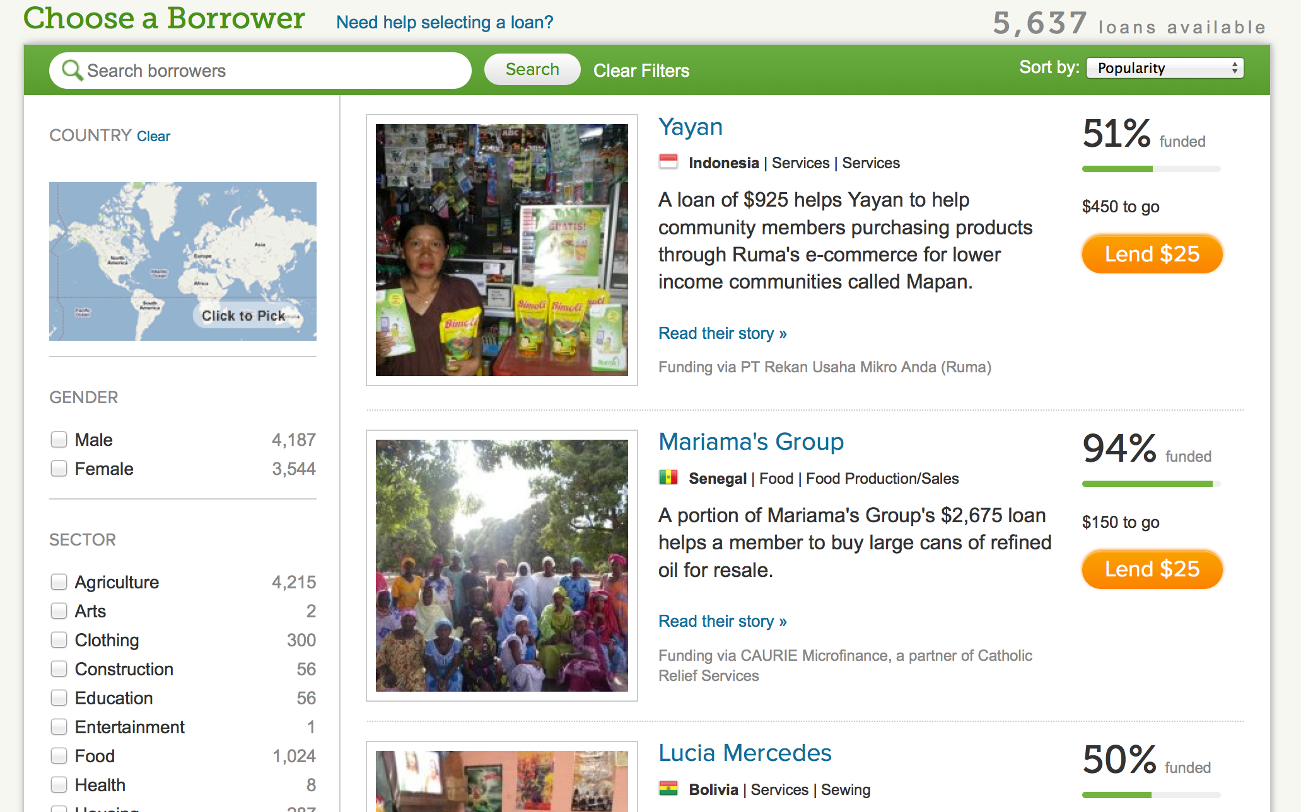
KIVA: INDIVIDUALIZATION OF LOANS

Slide 8
COURSES OF ACTION
“Everyone thinks of changing the world, but no one thinks of changing himself“
Leo Tolstoi
Options
Disruptor
Build Adaptive Capacities
Wait and See
Notes:
Bulkeley and Kern reported that institutional capacities are critical to effective urban climate change for three main reasons
First, to overcome the constraints of administrative structures,
Second, to overcome party politics and political timetables and
Third, to survive the loss of particular individuals
However,more information is required about the institution […], which are geared towards adaptive and mitigative responses to climate change, if the factors that engender effective and ineffective climate change responses are to be articulated.
Thus, to find out how urban climate policies can be effective the thesis purports to answer the research question

Slide 9
DETERMINANTS OF COURSES OF ACTION
Processes
Internal Governance
Difficult to change
Resources
Tangibles and Intangibles
Flexible
Values
Standards to prioritize decisions
Difficult to change
Notes:
Bulkeley and Kern reported that institutional capacities are critical to effective urban climate change for three main reasons
First, to overcome the constraints of administrative structures,
Second, to overcome party politics and political timetables and
Third, to survive the loss of particular individuals
However,more information is required about the institution […], which are geared towards adaptive and mitigative responses to climate change, if the factors that engender effective and ineffective climate change responses are to be articulated.
Thus, to find out how urban climate policies can be effective the thesis purports to answer the research question

Slide 10
Thank you
for your attention
Notes:
Bulkeley and Kern reported that institutional capacities are critical to effective urban climate change for three main reasons
First, to overcome the constraints of administrative structures,
Second, to overcome party politics and political timetables and
Third, to survive the loss of particular individuals
However,more information is required about the institution […], which are geared towards adaptive and mitigative responses to climate change, if the factors that engender effective and ineffective climate change responses are to be articulated.
Thus, to find out how urban climate policies can be effective the thesis purports to answer the research question

