Slide 1
Three Rounds Make a Ride
Multi-Actor Involvement in NGO Programme Implementation
Kim Sophie Schulte
23/05/15

Slide 2
About play it on
Originally founded in Denmark in 2014
Play It On Germany e.V. founded in May 2015
Main Goal: fostering global social responsibility

Slide 3
Challenges for Play It On
Funding
Human resources
Lack of mobility
Notes:
Great idea in mind: foster intercultural exchange via football → very popular sport all around the world
Lack of initial funding
Human resources: two students from Denmark, studied in Denmark, no opportunity to go to Uganda frequently

Slide 4
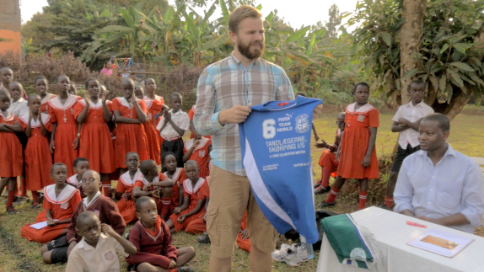
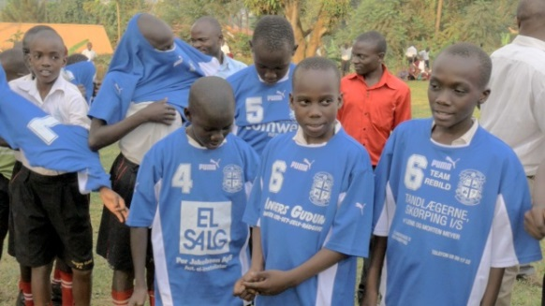
Conceptual Design
Donation of used sports gear in Denmark and Germany
Transportation to Uganda
Distribution to children at Ugandan school
Sports Clubs
Travelers
Partner NGO
Notes:
Donation:
Transport: travelers or travel groups goint to Uganda take a bag of sports gear with them → no expenditures, sustainable as we send people who would use a plane anyways to go there, mostly students from a local high school in Denmark who spent some time in Ugandan guest families
People who are interested in intercultural exchange and want to explore local life, not only interested in a tourist trip
CECOD is a UN-supported, but locally based non profit organization that, just like Play It On, works with development through education, sports and sustainability. The work with education, sports and sustainability is primarily done through CECOD’s participation in ‘The Climate Change Network of Eco Schools’ that has been operational since 1992. As such, CECOD forms part of an international Eco Schools Network, and in Uganda CECOD is responsible for around 300 public schools participation in this network. Each year CECOD realises a range of workshops and seminars, focused on educational aspects of environment and sustainability, for public schools in Uganda. The organization establishes amongst other things sustainability competitions for the schools that can win points and be certified as ‘eco-friendly’, which gives them access to privileges such as receiving sports gear for their environmental efforts.

Slide 5
Added Value Chain
Sports Clubs
Raising awareness of re-usage and sustainability
Travelers
Creating meaningful intercultural encounters
Partner NGO
Supporting Eco Schools Program
Children
Strengthening the right to play

Slide 6
Research Questions
In how far can NGOs work more efficiently by involving different groups of actors? In particular, what role can travelers play in the case of development NGOs?
In how far can and should development NGOs shift from a pure development mission to a more encompassing mission, including benefits to Northern societies?

Slide 7
Thanks for your attention!

