Slide 1
World Vision Azerbaijan
WV AZ office was opened in June 1994 in response to the humanitarian crisis as a result of military conflict with Armenia over Nagorno-Garabag
Initial interventions concentrated solely on relief work with the IDP and refugee communities from the conflict residing in camps, public buildings, dormitories, schools, etc.

Slide 2
Activities
During initial stages of intervention:
food distribution
shelter rehabilitation
water and sanitation,
health and nutrition support,
educational support
agricultural assistance
and the distribution of a variety of in-kind items
Later:
community development
income generation/micro-finance
education

Slide 3
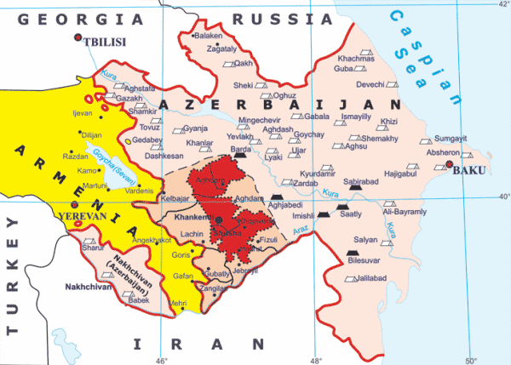
Donors
WFP
ECHO
ADB
UK Department For International Development (DFID)
USAID/MCI
ARRA (Government of Azerbaijan)
Dutch Government
Japan Fund for Poverty Reduction
MOFA of Japan
UNDP
CIDA
UNHCR
US Government
British Petroleum
private funding from WV

Slide 4
Target area
North-west, north-central, south-west and Absheron Peninsula regions including:
Baku, Ganje, Mingechevir and Sumgait cities (4)
Ter-Ter, Yevlax, Zardab, Agdam, Agjabedi, Agstafa, Barda, Beylegan, Fizuli, Goranboy, Imishli, Kurdamir, Qazax, Sheki and Shemkir districts (15)
Over 200,000 beneficiaries

Slide 5
Management (past)
8 offices in different locations
Over 200 staff (97% national) working in different and multi-sectoral projects

Slide 6
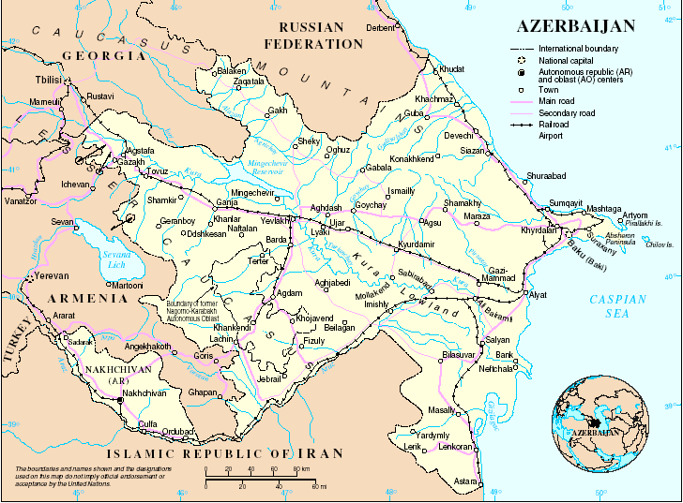
Baku
Zardab

Slide 7
Reasons for downsizing
End of relief operations in 2006
Limited resources in the country (government)
Lack of interest of external donors to fund activities in Azerbaijan
Lack of SO interest

Slide 8
Current Focus
Advocacy – 1) establishment of legal framework for the effective implementation of de-institutionalization, inclusive education, child protection, social work, etc; 2) development of new standards in professional technical education
Community Development – focusing on fostering and developing community organisations and empowering communities with the skills, abilities and confidence to take charge of their own development
Education – pioneer and leading agency in inclusive education, construction/rehabilitation of infrastructure, different capacity building activities for teachers, etc
Health – improving lives of mothers and children, HIV&AIDS, health education
Micro-Finance – provision of financial services for establishing and expanding income generation opportunities in both urban and rural contexts.

Slide 9
Current activities
“Establishing Community Services For the vulnerable children and Families in Azerbaijan Project”
Goal: To help the Government establish a child focussed community care system.
Beneficiaries: 19,400

Slide 10
Current activities
“Youth Development and Employment Network (YEN) ” Project
Goal: Support improvement of the professional technical education and youth entrepreneurship in Azerbaijan
Beneficiaries: 15,000

Slide 11
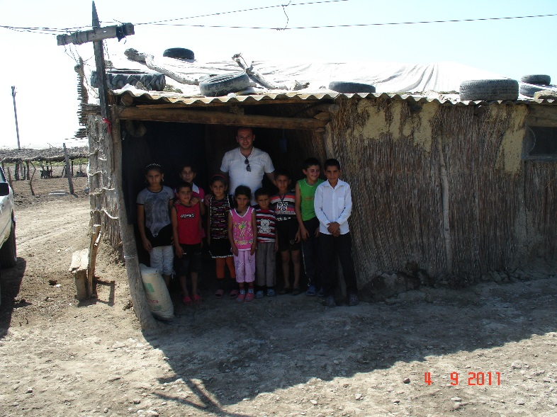
Current activities
Capacity Building and Economic Development Project (CBED)
Goal: Increased livelihood opportunities of the target communities through diversification and empowerment
Beneficiaries: 46,000

Slide 12
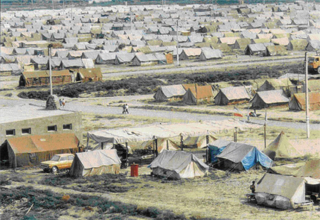
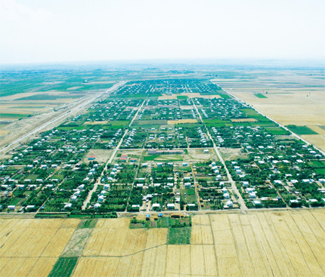
CBED

Slide 13
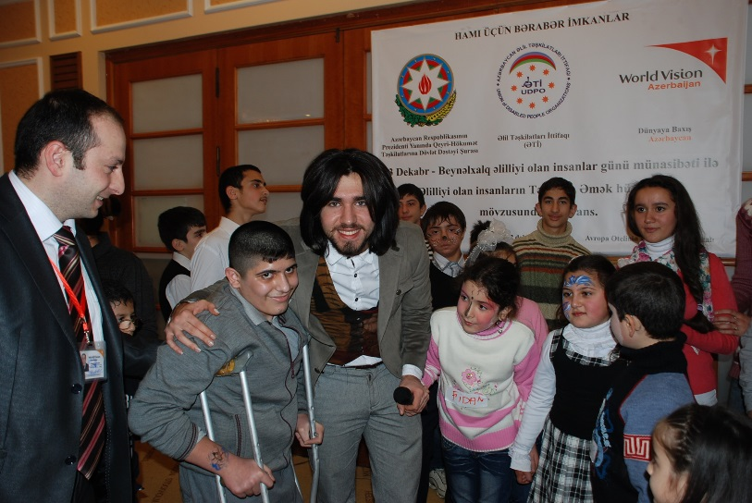
Current activities
“Improvement of the life of People and Children with Disabilities and inclusion into society” Project
Goal: To facilitate inclusion of P/CWDs into the society by means of two ways, 1. Contribute to the development of adequate environment for inclusive education; and 2. Facilitate community mobilization and support to the social inclusion of P/CWDs into community life .
Beneficiaries: 88 CWD for Secondary Inclusive Education (SIE), 11.800 people for Social Inclusion

Slide 14
Current activities
“Mobility Exacerbated HIV Prevention and Impact Mitigation” Project
Goal: Reduce mobility exacerbated risk and vulnerability to new HIV infections along with mitigating the impact of the epidemic in target communities of Southern Caucasus
Beneficiaries: 5,000

Slide 15
Current activities
Vision Fund AzerCredit LLC non-banking credit organization
Goal: World Vision AzerCredit LLC exists to promote sustainable development by extending credit to low-income people
Beneficiaries: 40,000 clients

Slide 16
Management (present)
WV Azerbaijan
2 offices (Baku and Mingechevir)
22 staff (94% national) working in different and multi-sectoral projects
Azercredit LLC
9 offices in different locations
93 staff (99% national)

Slide 17
Baku

Slide 18
WV Az in education sector
Rehabilitation/construction of schools
Provision of equipment and materials to improve the quality of education
Participation in the preparation of and support to the implementation of the State DI Program
Experience in working with children in special institutions
Experience in child rights protection
Leader player in inclusive education sine 2004
Advocacy for changing attitudes, practices and policies

