Slide 1
Civil Society in Japan
Maki KAITA, the graduate student,
Graduate School of Humanities and Social Sciences Doctoral Program in Modern Cultures and Public Policies
University of Tsukuba

Slide 2
What is Civil Society?
Civil Society occupies a public sphere in which neither government, market nor family plays a enough role.
Society
Government
Civil Society
NGO
NPO
NIO
Market
Family

Slide 3
Japan Intro. Puzzles Why Japan’s government is so small?
Index① Total tax ratio as percentage of GDP, 2010 (OECD 34)
Japan 27.6%
Japan is ranked 7th from the bottom
(after Mexico, Chile, USA, Korea, Australia, Turkey) out of 34 OECD countries.
OECD Average 33.8%
EU 21 average 37.1%

Slide 4
Tax Revenue % of GDP(OECD, 2010)

Slide 5
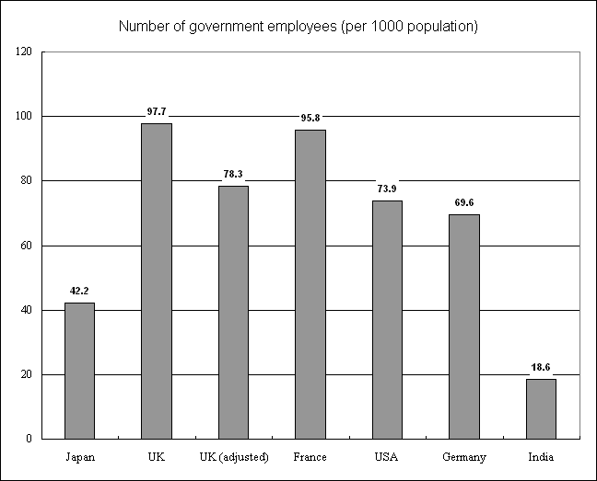
Puzzle Index ②: Size of Gov’t Employees as broad definition.
Nomura Research Institute (2005)

Slide 6
Q. Why “good” performance under “small” government?
No easy answer, but let us consider Civil Society Organizations (CSOs).
Because CSOs can contribute to the performance of government by
forming both human capital and social capital (human network, trust, reciprocity), and supplying those capitals to government supporter groups.
Reducing and lightening the government burden.
Reservation：market, company/family may matter.

Slide 7
Civil society in Japan : long history
The term “citizen”: “Shimin”
(translated by Y. Fukuzawa: 1835-1901)
Origins of CSOs: Predecessor in the Edo Era (1603-1868)
Waves of democratization emerged since Meiji revolution.
*Meiji Era (1868-1912)
The emergence of NGOs and NPOs
1970s: Citizen, Residents’ movements
1980s: NGOs,1990s: NPOs (enactment of NPO law’98)
The visible rise of Volunteers and Civil Society
1995: Great Hanshin-Awaji Earthquake (and 2011)
Civil society in Japan: Distinctive, and different from Western understandings (“Members without advocacy,” R. Pekknanen 2006.)

Slide 8
Brief introduction of Surveys: JIGS1st and JIGS2nd Rounds * JIGS=Japan Interest Group Survey
In order to grasp civil society free of Western bias, Prof. Tsujinaka started the world-wide CSO surveys in 1997.
Until 2010, 13 countries (JPN, RK, USA, G, PRC, TR, R, Ph, Br, Bg, Uz, Est, Pol ), more than 55,000 assn. data collected in JIGS 1st and JIGS 2nd
We did conduct more comprehensive surveys including grass-root Neighborhood Associations (especially in Japan) since 2006.

Slide 9
1. Survey Overview
Country | Year | Data Source / Survey Method | Population | Sample (a) | Valid Response(b) | Return Rate(%) (b/a) | Regions (Valid Return Sample)
1.Japan | '97 | classified telephone directory/ mail | 23,128 | 4,247 | 1,635 | 38.5 | Tokyo (1,438) Ibaraki (197)
2.Korea | '97 | classified telephone directory / mail | 11,521 | 3,890 | 493 | 12.7 | Seoul (371) Kyonggi (110)
3.USA | '99 | classified telephone directory / mail | 7,228 | 5,089 | 1,492 | 29.3 | Washington, D.C. (748) North Carolina (752)
4.Germany | '00 | classified telephone directory, organization directory / mail | 4,806 | 3,100 | 885 | 28.8 | Berlin (643) Halle (154)
5.China | '01-02 '03-04 | “Social Groups” officially registered at the Municipal or District/Country Civil Affairs Bureau / mail | 9,536 | 8,897 | 2,858 | 32.1 | Beijing (627), Zhejiang(1,782), Heilongjiang (449)
6.Russia | '03-04 | Registered Organizations（NGO） Database / mail | 2,974 | 1,500 | 711 | 47.4 | Moscow (411) Saint Petersburg (300)
7.Turkey | ‘03-04 | Regional survey investigation based on telephone directory / interview | 15,730 | 3,146 | 841 | - | Ankara ( 334 ) Istanbul ( 507 )
8.Philippine | '04-05 | Securities and Exchange Commission (SEC), Philippine Foundation Center (PFC) / interview | 44,051 | 5,172 | 1,014 | 18.5 | Manila (855) Cebu (159)

Slide 10
2. Overview of JIGS Surveys
Country | Year | Data Source / Survey Method | Population | Sample (a) | Valid Response(b) | Return Rate(%) (b/a) | Regions (Valid Return Sample)
9.Brazil | '05-06 | Brazilian Institute of Geography and Statistics (IBGE), organization directory / interview | 275,895 | 2,609 | 2,014 | 77.2 | Belem (193), Belo Horizonte (390), Brasilia (1,132), Goiania (115), Recife (170)
10.Bangladesh | '06-07 | Telephone books, Directories | 29,528 | 5,915 | 1,509 | 25.5 | Rajshahi (504), Dhaka (1,005)
11.a Japan (2nd) | '06-'07 | classified telephone directory/ mail | 91,101 | 91,101 | 15,791 | 17.3 | Nationwide Survey Japan
11.b Japan | '06-'07 | Registered Organizationｓ（NGO） Database / mail | 23,403 | 23,403 | 5,127 | 21.9
11.c Japan | '06-'07 | Registered Neighborhood Associations (MP)/ mail | 296,770 | 33,438 | 18,404 | 55.0

Slide 11
3. Overview of JIGS Surveys
Country | Year | Data Source / Survey Method | Population | Sample (a) | Valid Response(b) | Return Rate(%) (b/a) | Regions (Valid Return Sample)
12. Germany (2nd) | '07-08 | classified telephone directory / mail | 4,657 | 2,660 | 497 | 18.7 | Berlin (354), Halle (82), Heidelberg (61)
 |  | organization directory (NGO)/ mail | 13,717 | 1,899 | 312 | 16.4 | Nationwide Survey Germany
13. Korea (2nd) | '08-09 | classified telephone directory/ mail | 112,917 | 29,422 | 1,008 | 3.4 | Nationwide Survey Korea
 |  | organization directory (NGO)/ mail | 7,030 | 7,030 | 425 | 6.0
14. China (2nd) | '09-10 | “Social organizations,” “Non- profit private enterprise,” “foundations” registered at the Municipal or District/ Civil Affairs Bureau / Mail/ conference | 19,799 |  | 1,776 |  | Beijing ( ), Zhejiang( ), Heilongjiang ( yet)

Slide 12
4. Overview of JIGS Surveys
Country | Year | Data Source / Survey Method | Population | Sample (a) | Valid Response(b) | Return Rate(%) (b/a) | Regions (Valid Return Sample)
15. USA (2nd) | '08-09 | organization directory (NPO) / mail, web, phone | 8,524 | 4,297 | 1,501 | 34.9 | Seattle, King County
 | ’09-10 | organization directory (NPO) / mail, web, phone |  | 3,300 | 571 | 17.3 | D.C. (237) Maryland (133) Virginia (201)
16. Uzbekistan | ‘07-08 | organization directory / mail | 1,541 | 1,541 | 400 | 26.0 | Nationwide Survey Uzbekistan
17. Estonia | '09 | classified phone directory / web |  |  | 344
18. Poland | '09-10 | organization directory (REGON) | 22,361 | 3,000 | 261 | 8.7 | Mazowieckie (128) Lubelskie (56) Dolnoslaskie (77)

Slide 13
5. Nationwide Surveys in Japan
 | On Social Organizations | On Non Profit Organization | On Neighborhood Associations | On Local Governments
Survey Period | February 2006 to March 2007 | February 2006 to March 2007 | August 2006 to February 2007 | August 2007 to December 2007
Population Size | 91,101 (no. of samples by phone directories) | 23,403 (no. of accredited NPOs) | 296,770 (by Ministry of Internal Affairs & Communication) | 1,827 (no. of those at the time of survey)
Survey method | Mailing method | Mailing method | Mailing & Placement method | Mailing method
No. of samples distributed | 91,101 (Whole survey) | 23,403 (Whole survey) | 32,298 (Sample Survey) | 1,827 (Whole survey)
No. of samples collected | 15,791 | 5,127 | 18,404 | 1,179
Return rate | 17.3％ | 21.9% | 55.0% | 64.6%

Slide 14
Ⅰ. International Comparison
(1) Formation (year established)
(2) Composition of CSO sectors and types
(3) Range of CSO Activities
(4) Experience on Success to influence
policies
(5) Self-evaluated Political Influence
(6) Effective lobbying target

Slide 15
(1) Formation: The global “associational revolution” ar.1990s and 2000s: JIGS database, nation-wide. JIGS database
Notes:
15

Slide 16
(2) CSOs’ 4 Sectors
Profit (market-CSOs, not including company) sector:
Trade associations, labor unions, economic organizations
Non-profit (social service) sector:
Organizations related law, accounting, education, welfare, medicine
Citizen (individual membership) sector:
Organizations where citizens can be involved in various
activities related to politics, religion, sports, or hobbies
Other:
Those do not fit in the above three categories

Slide 17
(2) Composition: CSOs’ 4 Sectors’ Proportion (capital areas)
Profit Superiority
(≒40%)
Japan・China
Non-P. Superiority
(≒40%)
US・Germany・Estonia・Poland
Citizen Superiority (≒50%)
Russia・Philippines (Korea・ Brazil)
Balanced
Bangladesh
Other (≒60%)
Turkey

Slide 18
(2) Japan: by Group categories
18

Slide 19
(3) Range of CSO Activities (Capital Areas)

Slide 20
(4) Experience on Success to influence policies(%): Enact, Modify or Stop Policies(capital areas)
Estonia(2009) | 56.25
Korea(2009) NPO | 54.87
USA Washington D.C.(2010) NPO | 51.90
Russia(2004) | 48.18
Japan(2007) NPO | 41.36
Germany(2000) | 37.64
Korea(2009) | 30.15
Japan(2007) | 29.91
Poland(2010) | 23.44
Philippine(2004) | 20.35
Uzbekistan(2008) NPO | 17.14
Bangladesh(2007) | 15.32
Brazil(2006) | 8.04
China(2010) | 6.48
Turkey(2004) | 5.69

Slide 21
(5) Self-evaluated Political Influence: Average of “0=No Influence” ,“~ 4=Very Strong”
(capital areas)
Even if CSOs cannot influence policies directly,
Influences of their grass-roots activities can be evaluated highly.

Slide 22
(6) Effective lobbying target (in capital areas, %)
 | Legislature²⁾/Congress | Administration | Court
Japan (JIGS1) | 14.5 | 35.7 | 6.5
Japan (JIGS2_Social Assn.) | 31.5 | 64.4 | 4.5
Japan (JIGS2_NPO) | 29.6 | 70.5 | 2.7
Korea | 12.1 | 62.5 | 3.2
USA | 38.4 | 24.9 | 2.8
Germany (JIGS1) | 8.7 | 15.9 | 7.6
China | 4.5 | 18.5 | 2.4
Russia | 11.4 | 13.9 | 12.9
The Philippines | 15.8 | 40.4 | 6.2
Turkey³⁾ | 7.5 | 28.7 | 66.2
Brazil | 8.8 | 9.6 | 9.2
Bangladesh | -- | -- | --
Notes: l) Percentage of the first choice 2) In China, this is the National People’s Congress. 3) In Turkey, we asked whether these areas are effective as a lobbying target. The respondents were allowed to choose more than one area.

Slide 23
Ⅱ Neighborhood Association (“Jichikai” in Japanese)
Definition：voluntary groups whose memberships is geographically limited, and whose activities are multiple and are centered on that same area. （Pekkanen 2006）
300,000 groups exist all over Japan (Totally 98.9% covered by our survey) for social service for local residents and bridge bet. Administration and residents. Essential for local residents.
Increase of unofficial complaint on the decay or castration of the neighborhood associations.
➢Need to study the reality by nationwide survey.

Slide 24
(1) NHAs in Civil Society
3 Functions in Civil Society
１）Building Social Capital
２）Providing Social Services
３）Public Support for groups: Advocacy
Neighborhood associations: expected to carry out the above 3 functions in Japanese local societies.

Slide 25
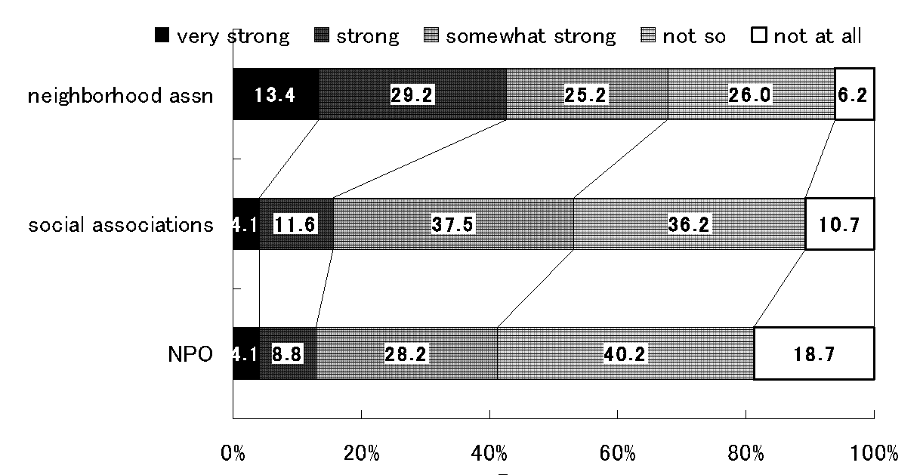
(2) Influence of neighbourhood associations, social associations and NPOs at the city, town and village level . (NHA is stronger in Japan) JIGS2 data nation-wide

Slide 26
(3) Scale of Neighborhood associations

Slide 27
(5) Social Service Activities Conducted by Neighborhood Associations
 | Traditional Rural (%) | New rural (%) | Traditional urban (%) | new urban (%) | All (%)
Cleaning and beautification | 87.1 | 89.3 | 88.3 | 91.0 | 88.5
Residential road management | 86.7 | 79.3 | 91.0 | 89.4 | 87.2
Festivals | 74.3 | 62.4 | 82.1 | 74.5 | 74.6
Support for the elderly | 66.4 | 60.4 | 78.6 | 78.6 | 70.9
Garbage disposal | 67.2 | 68.6 | 70.9 | 73.1 | 69.5
Ceremonial events | 73.2 | 61.2 | 66.2 | 68.0 | 68.9
Sports and cultural events | 58.7 | 63.9 | 72.6 | 74.5 | 65.8
Cooperation with school education | 60.9 | 53.2 | 70.8 | 69.3 | 63.8
Meeting hall management | 66.8 | 55.3 | 64.7 | 60.8 | 63.5
Fire prevention | 60.2 | 50.8 | 65.0 | 59.1 | 59.8
Disaster prevention | 50.9 | 48.4 | 62.8 | 62.5 | 55.7
Traffic safety | 49.7 | 46.4 | 63.8 | 55.8 | 53.8
Crime | 42.2 | 50.0 | 64.7 | 66.3 | 53.4
Youth development | 45.5 | 46.9 | 62.5 | 61.7 | 52.9
Bulletin board management | 36.6 | 45.2 | 62.1 | 67.8 | 50.0

Slide 28
(6) Coordination with other association
 | Traditional rural | New rural | Traditional Urban | New Urban | Total
Senior citizen club | 78.6 | 61.1 | 85.9 | 79.3 | 78.1
Community works association | 72.6 | 74.8 | 83.7 | 84.9 | 78.0
Kids club | 74.1 | 74.6 | 83.5 | 82.0 | 78.0
“JICHIREN” | 59.2 | 68.8 | 82.7 | 85.4 | 71.3
PTA | 65.5 | 60.8 | 76.8 | 73.4 | 69.1
Fire brigade | 72.5 | 53.5 | 73.6 | 60.5 | 67.8
Crime prevention | 47.8 | 52.8 | 71.1 | 69.7 | 58.4
Athletic association | 53.3 | 50.4 | 62.8 | 55.5 | 55.6
Other Neighborhood association | 44.9 | 50.4 | 57.7 | 60.5 | 51.8
Women`s association | 53.7 | 37.4 | 55.5 | 44.1 | 50.0
Police station | 38.3 | 45.1 | 61.5 | 63.3 | 49.7
Fire Station | 36.0 | 41.2 | 59.4 | 59.2 | 46.9
Guardian diety group” | 52.8 | 25.4 | 50.9 | 26.1 | 43.3
Unit: %

Slide 29
Summary：Common Characteristics of Neighborhood Associations
High participation rate
Main members are retired elderly men
Cooperation with children clubs, senior citizens' clubs and social welfare councils
Conducting cleaning and beautification, residential road management and support for the elderly
Rotating message board, distributing PR magazines and fund-raising (cooperation with local government)
Requesting activities to local government officials

Slide 30
Conclusion (1) on civil society in Japan
Japan has a rich, complex, well-rooted civil society, while the term is relatively new.
No recent “associational revolution,” rather robust post-war structure.
Profit (producer, market type) CSOs dominate. (Developmental CSOs)
Targeting Public Administration.
Feeling moderate influence in terms of collaboration.
Strong and confident grass-root NHAs.

Slide 31
Conclusion (2) on politics in Japan
This CSOs’ cooperative, developmental/grass-rooted nature may have reduced government load and promoted stable governance with small public sector.
This also may have supported the good environmental policy implementation in Japan.
But Japan is now in flux, under severe globalization, fiscal deficit and demands by CS.
CSO is suffering fiscal problem and facing turning point as well.

Slide 32
1.Civil Society Organization Map
32

Slide 33
Thank you so much!
Our website: “CAJS=Center for International, Comparative, and Advanced Japanese Studies”
http://cajs.tsukuba.ac.jp/en/

