Slide 1
THE NEW GOVERNANCE
AND THE
CHANGING TOOLS OF
PUBLIC ACTION
Lester M. Salamon
Johns Hopkins University and
Higher School of Economics
HSE April Conference, 8 April 2015

Slide 2
THE NEW GOVERNANCE
A revolution in the technology of public action
Proliferation of new tools
Lester M. Salamon, The Tools of Government: A Guide to the New Governance, (New York: Oxford University Press, 2002).

Slide 3
THE NEW GOVERNANCE
Illustrative tools
Direct government
Contracts
Grants
Direct loans
Loan guarantees
Economic regulation
Social regulation
Corrective fees
Lester M. Salamon, The Tools of Government: A Guide to the New Governance, (New York: Oxford University Press, 2002).

Slide 4
THE NEW GOVERNANCE
The beat goes on
Tort law
Administrative adjudication
Vouchers
Tax expenditures
Carbon credits
Social impact bonds
Lester M. Salamon, The Tools of Government: A Guide to the New Governance, (New York: Oxford University Press, 2002).

Slide 5
THE NEW GOVERNANCE
Rise of third-party government
Common feature: Use of “Third Parties”
Sharing of discretionary authority
“Deconstruction” of public action
Lester M. Salamon, The Tools of Government: A Guide to the New Governance, (New York: Oxford University Press, 2002).

Slide 6
THE NEW GOVERNANCE
Deconstruction of public action
FINANCE
DELIVERY
Public
Private
Public
(1) National
A
C
(2) State/local
Private
(1) Nonprofit
B
D
(2) For-profit
Lester M. Salamon, The Tools of Government: A Guide to the New Governance, (New York: Oxford University Press, 2002).

Slide 7
THE NEW GOVERNANCE
SCALE OF U.S. FEDERAL GOVERNMENT ACTIVITY,
BY TYPE OF TOOL, FY1999
Amount ($ bns)
%
DIRECT GOVERNMENT
Goods and Services
Income support
Interest
Direct loans (obligations)
SUBTOTAL, DIRECT
186.8
550.4
229.7
38.4
1005.3
28.1%
INDIRECT GOVERNMENT
198.8
286.4
251.0
602.0
252.4
409.2
376.1
200.0
2575.9
Contracting
Grants
Vouchers
Tax expenditures
Loan guarantees (commitments)
GSEs (loans)
Deposit insurance (net additions)
Regulation
SUBTOTAL, INDIRECT
71.9%
GRAND TOTAL
3581.2
100.0%
Lester M. Salamon, The Tools of Government: A Guide to the New Governance, (New York: Oxford University Press, 2002).

Slide 8
THE NEW GOVERNANCE
Sources Of Civil Society Revenue, 34-Country average
PHILANTHROPY
12%
GOVERNMENT
35%
FEES
53%

Slide 9
THE NEW GOVERNANCE
Sources of Civil Society Revenue, by Country
GOVERNMENT DOMINANT
FEES, CHARGES
GOVERNMENT
PHILANTHROPY
ALL COUNTRIES
53 %
35 %
12%
Ireland
16%
77%
7%
Belgium
19%
77%
5%
Germany
32%
64%
3%
Israel
26%
64%
10%
Netherlands
39%
59%
2%
France
35%
58%
8%
Austria
43%
50%
6%
Canada
39%
51%
9%
United Kingdom
45%
47%
9%
Romania
29%
45%
26%
South Africa
32%
44%
24%
% may not add to 100 due to rounding
Notes:
35 Countries, without volunteers

Slide 10
THE NEW GOVERNANCE
Why?
Complexity of problems
Limits on public resources
Dissatisfaction with government performance
Popularity of market ideology
Producer political power
Lester M. Salamon, The Tools of Government: A Guide to the New Governance, (New York: Oxford University Press, 2002).

Slide 11
THE NEW GOVERNANCE
Existing theories limited
New public management
Privatization
Lester M. Salamon, The Tools of Government: A Guide to the New Governance, (New York: Oxford University Press, 2002).

Slide 12
THE NEW GOVERNANCE
Needed: a new paradigm new governance
“Governance”
collaboration,
interdependence
“New”
recognition
of challenges
Lester M. Salamon, The Tools of Government: A Guide to the New Governance, (New York: Oxford University Press, 2002).

Slide 13
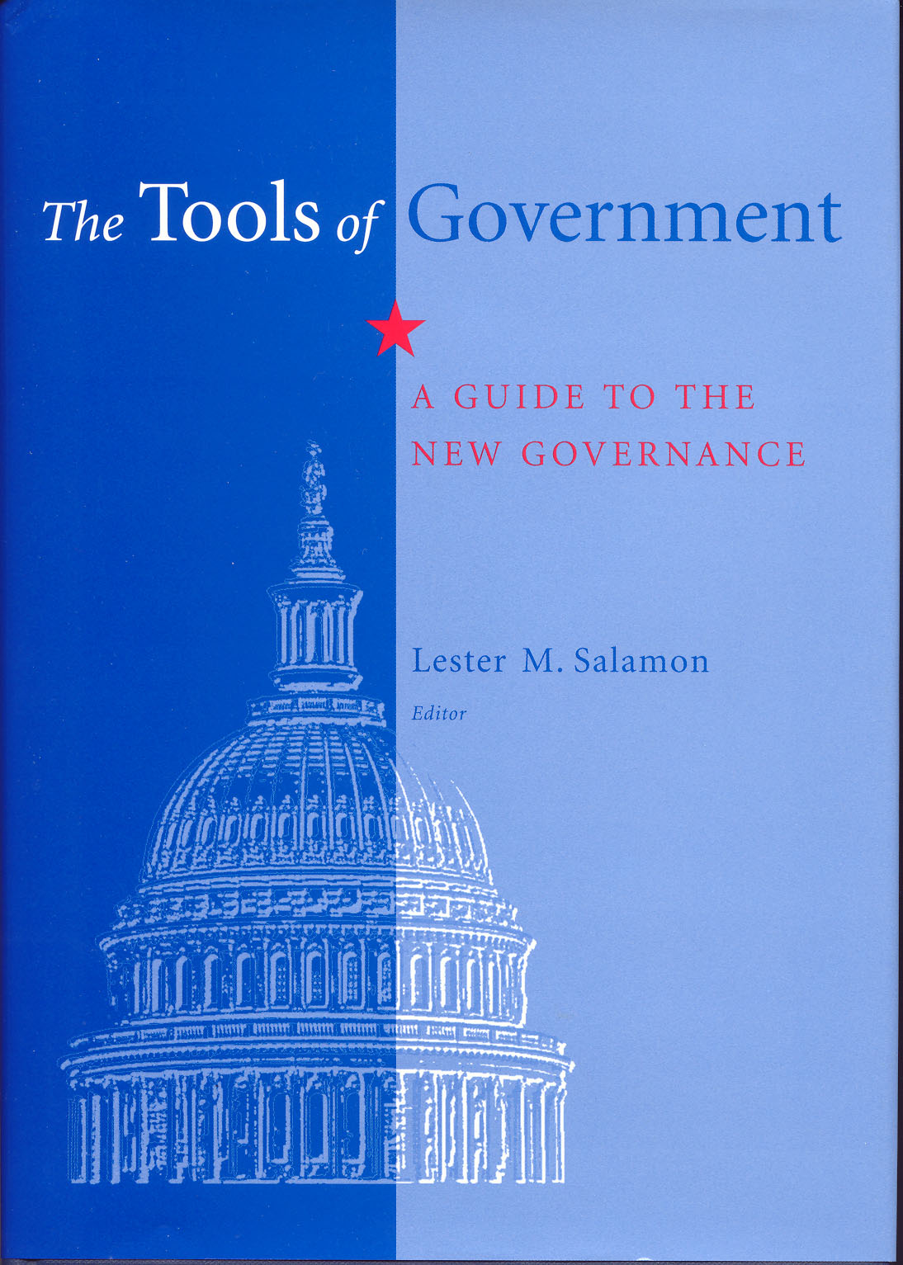
The New Governance

Slide 14
THE NEW GOVERNANCE
The new governance paradigm
Classical Public
Administration
New
Governance
Program/Agency
Tool
Lester M. Salamon, The Tools of Government: A Guide to the New Governance, (New York: Oxford University Press, 2002).

Slide 15
THE NEW GOVERNANCE
definition
“A tool of public action is an
identifiable method through which
collective action is structured
to address a public problem.”
Lester M. Salamon, The Tools of Government: A Guide to the New Governance, (New York: Oxford University Press, 2002).

Slide 16
THE NEW GOVERNANCE
TOOLS AS BUNDLES OF ATTRIBUTES
Good or activity
Delivery vehicle
Delivery system
Rules and procedures
Lester M. Salamon, The Tools of Government: A Guide to the New Governance, (New York: Oxford University Press, 2002).

Slide 17
THE NEW GOVERNANCE
Political economy of tools
Actors
SOPs
Skills
Tasks
Advantages
Lester M. Salamon, The Tools of Government: A Guide to the New Governance, (New York: Oxford University Press, 2002).

Slide 18
THE NEW GOVERNANCE
Classification: tool dimensions
Coerciveness
Directness
Visibility
Automaticity
Consumer side vs. producer side
Lester M. Salamon, The Tools of Government: A Guide to the New Governance, (New York: Oxford University Press, 2002).

Slide 19
THE NEW GOVERNANCE
Not just technical choices
Tool choices as technical choices
Tool choices as political choices
Lester M. Salamon, The Tools of Government: A Guide to the New Governance, (New York: Oxford University Press, 2002).

Slide 20
THE NEW GOVERNANCE
The new governance paradigm
Classical Public
Administration
New
Governance
Program/Agency
Tool
Hierarchy
Network
Lester M. Salamon, The Tools of Government: A Guide to the New Governance, (New York: Oxford University Press, 2002).

Slide 21
THE NEW GOVERNANCE
HIERARCHY➔NETWORK
Principal Agent Theory
Network Theory
Pluriformity
Self-referentiality
Asymmetric interdependencies
Dynamism
Lester M. Salamon, The Tools of Government: A Guide to the New Governance, (New York: Oxford University Press, 2002).

Slide 22
THE NEW GOVERNANCE
The new governance paradigm
Classical Public
Administration
New
Governance
Program/Agency
Tool
Hierarchy
Network
Public vs. Private
Public + Private
Command & control
Negotiation & persuasion
Management skills
Enablement skills
Lester M. Salamon, The Tools of Government: A Guide to the New Governance, (New York: Oxford University Press, 2002).

Slide 23
THE NEW GOVERNANCE
Needed: new enablement skills
Activation
Orchestration
Modulation
Lester M. Salamon, The Tools of Government: A Guide to the New Governance, (New York: Oxford University Press, 2002).

Slide 24
THE NEW GOVERNANCE
Challenges: for governments
Management Challenge
Accountability Challenge
Legitimacy Challenge
Lester M. Salamon, The Tools of Government: A Guide to the New Governance, (New York: Oxford University Press, 2002).

Slide 25
THE NEW GOVERNANCE
Challenges: for partners
Loss of autonomy
Vendorism & mission drift
Bureaucratization
Lester M. Salamon, The Tools of Government: A Guide to the New Governance, (New York: Oxford University Press, 2002).

Slide 26
THE NEW GOVERNANCE
Needed: new knowledge
Tool knowledge
Lester M. Salamon, The Tools of Government: A Guide to the New Governance, (New York: Oxford University Press, 2002).

Slide 27
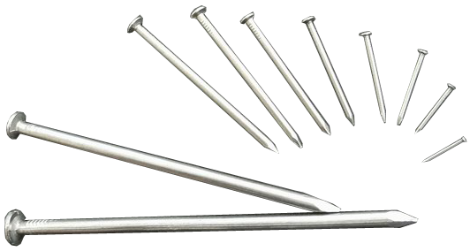
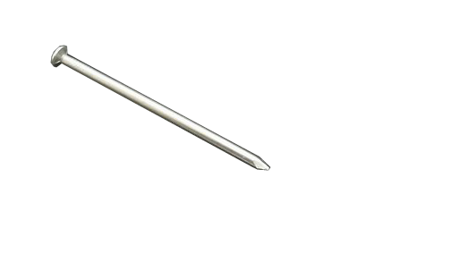
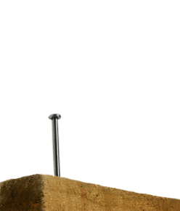
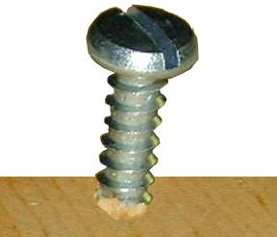
THE NEW GOVERNANCE
Tool knowledge

Slide 28
THE NEW GOVERNANCE
Needed: new knowledge
Tool knowledge
Design knowledge
Operational knowledge
Lester M. Salamon, The Tools of Government: A Guide to the New Governance, (New York: Oxford University Press, 2002).

Slide 29
THE NEW GOVERNANCE
Needed: new sensitivities
By partners: for the accountability needs of government
By governments: for the distinguishing functions of private partners
Lester M. Salamon, The Tools of Government: A Guide to the New Governance, (New York: Oxford University Press, 2002).

Slide 30
THE NEW GOVERNANCE
SENSITIVITY TO PARTNER CHARACTISTICS: E.G.–multiple functions of nonprofits
Service provision
Advocacy
Expression
Community-building / social capital
Value guardian / mobilization
Lester M. Salamon, The Tools of Government: A Guide to the New Governance, (New York: Oxford University Press, 2002).

Slide 31
THE NEW GOVERNANCE
Needed: new public service
“Professional citizens”
Network managers
Lester M. Salamon, The Tools of Government: A Guide to the New Governance, (New York: Oxford University Press, 2002).

Slide 32
THE NEW GOVERNANCE
conclusion
“It is harder to operate a
constitution than to frame one.”
~Woodrow Wilson
Lester M. Salamon, The Tools of Government: A Guide to the New Governance, (New York: Oxford University Press, 2002).

Slide 33
The New Governance/
Oxford University Press

