Slide 1
Enabling Environment for Innovations in arts and cultural sector
Olga Kononykhina,
PhD candidate Heidelberg University;
Research associate Hertie School of Governance;
kononykhina@hertie-school.org

Slide 2
Public spheres
State
Market Family

Slide 3
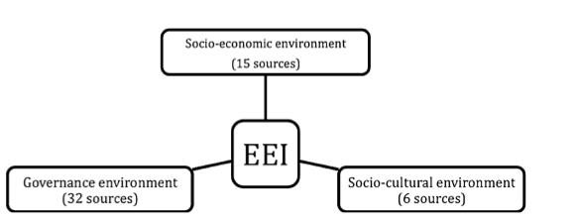
Civil Society Enabling Environment – Global Capability Index

Slide 4
Civil Society Enabling Environment – Global Capability Index
Socio-economic environment | Socio-cultural environment | Governance environment
Education Communications Equity Gender equality | Propensity to participate Tolerance Trust Giving and volunteering | Civil society infrastructure Policy dialog Corruption Political rights and freedoms Associational rights Rule of law Personal rights NGO legal content Media freedoms

Slide 5
Enabling Environment = Innovative environment?
Socio-economic
Socio-cultural
Governance
INNOVATIVE ENVIRONMENT

Slide 6
NOT EVEN IN
ARTS AND CULTURE??

Slide 7
Innovations are hard
Can’t find a good problem
Don’t generate good ideas
Don’t choose the best ideas
Don’t anticipate innovations constrains

Slide 8
Some examples of innovations in arts/cultural sector
Looking elsewhere: staff exchange between partners/within network
Learning alongside your peers: learning network to develop competencies
Circulation of ideas and opinions: changing work environment, teambuilding
Joining forces to act together: sustainability fund; collaboration with business (contact improvisation as a teambuilding), government organisations (UNICEF)
Transforming organisation in a changing world: dealing with motivation and growth in a small organisation

Slide 9
Some examples of innovations in arts/cultural sector
B-tour
Theater Scouting
Creative Mornings
ISIDINGO
Dancing traffic light

Slide 10
Innovative solutions overcome constrains
Looking within
Individuals
Groups
Organisations
Looking outside
Market
Society
Technology

Slide 11
Enabling environment for Innovations:
Individuals must enlarge their toolsets
Groups culture must support risks
Organisations must have a strategy
Market must see utility and value
Society must accept as legitimate
Technology must be developed

Slide 12
Constrains
Individual constrains: Perception / Intellection / Expression
Groups constrains: Culture/emotion / environment / process
Organisational constrains: Structure / strategy / resources
Market constrains: Competition / suppliers / markets
Society constrains: Values / regulations / history
Technology constrains: Knowledge / time / environment

Slide 13
Thank you for your attention!

