Slide 1
Young Expert‘s Workshop

Slide 2
Berlin: Hertie School of Governance

Slide 3
Rostock: Max Planck Institute for Demographic Research
Berlin: Hertie School of Governance

Slide 4
Demography
Death
?
NGO
Birth
Migration
Population
Structure

Slide 5
Fertility Behavior in
Russia and Germany

Slide 6
Relevance

Slide 7
Relevance

Slide 8
Relevance
“Jetzt wächst zusammen,
was zusammengehört.”
Willy Brandt, 10. Nov. 1989
Fall of
Berlin Wall
Legal
Unification
Jan
Feb
Mar
Apr
Mai
Jun
Jul
Aug
Sep
Oct
Nov
Dec
Jan
Feb
Mar
Apr
Mai
Jun
Jul
Aug
Sep
Oct
Nov
Dec
Jan
1989 1990 1991

Slide 9
Relevance
Constitutional „Right to Work“
„Labor Market Integration“ of Women
Secularization
Notes:
9

Slide 10
Fertility Trends

Slide 11
Fertility Trends
Total Fertility Rate
2.5
2.0
1.5
West
Germany
1.0
0.5
0.0
1980
1990
2000
2010

Slide 12
Fertility Trends
Total Fertility Rate
2.5
2.0
1.5
West
Germany
1.0
East
Germany
0.5
0.0
1980
1990
2000
2010

Slide 13
Fertility Trends
Total Fertility Rate
2.5
2.0
1.5
West
Germany
1.0
East
Germany
0.5
0.0
1980
1990
2000
2010

Slide 14
Fertility Trends
Monthly Total Fertility Rate (TFR)
Fall of Berlin Wall
+ 9 months
2.0
1.5
West Germany
1.0
East Germany
0.5
0.0
Jan-90
Jan-91
Jan-92
Jan-93

Slide 15
Fertility Trends
Monthly Total Fertility Rate (TFR)
Fall of Berlin Wall
+ 9 months
2.0
1.5
West Germany
1.0
East Germany
0.5
0.0
Jan-90
Jan-91
Jan-92
Jan-93

Slide 16
Fertility Trends
Total Fertility Rate
2.5
2.0
1.5
West
Germany
1.0
East
Germany
0.5
0.0
1980
1990
2000
2010

Slide 17
Fertility Trends
Total Fertility Rate
2.5
2.0
Russia
1.5
West
Germany
1.0
East
Germany
0.5
0.0
1980
1990
2000
2010

Slide 18
Fertility Trends
Total Fertility Rate
2.5
Replacement Level
2.0
Russia
1.5
West
Germany
1.0
East
Germany
0.5
0.0
1980
1990
2000
2010

Slide 19
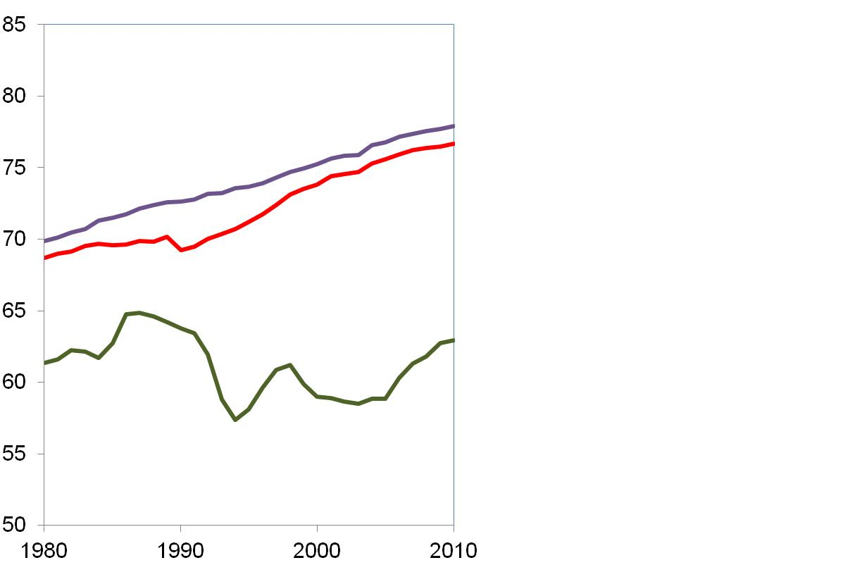
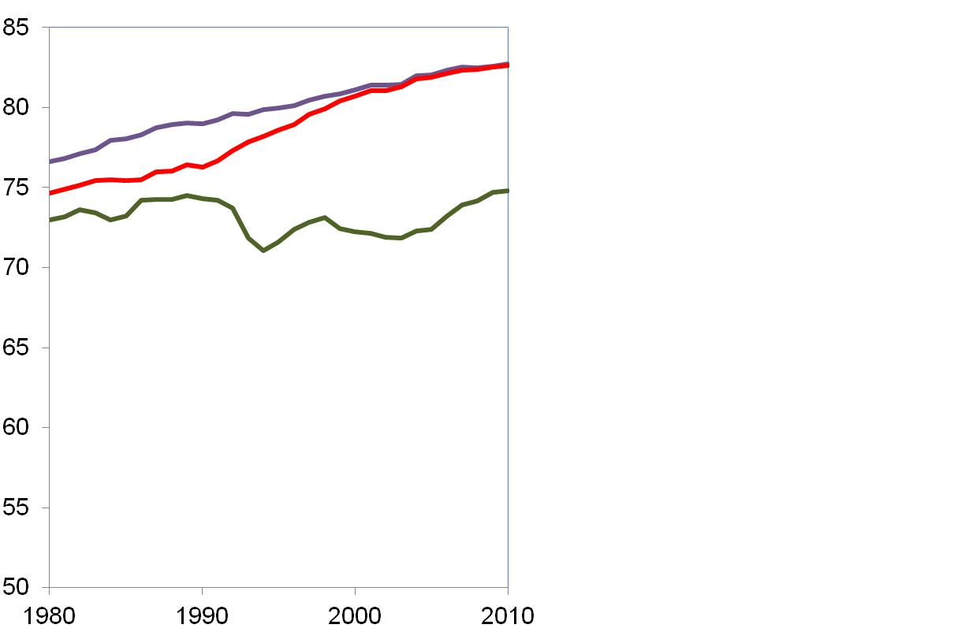
Fertility Trends
Life Expectancy Men
Life Expectancy Women
West
Germany
West
Germany
East
Germany
East
Germany
Russia
Russia
Source: HMD

Slide 20
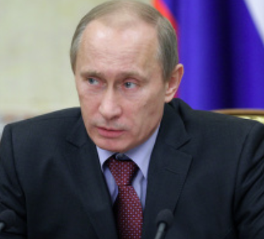
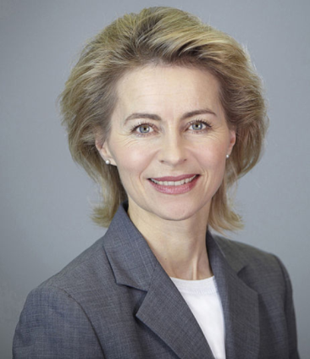
Fertility Trends
Our population is declining …
we need to raise the birth rate!
(Putin 2006)
The challenge of family policies is to facilitate family formation.
(Deutscher Bundestag, 2006)

Slide 21
Fertility Trends
Cash benefits for higher order births
Parental leave benefit reform
Expansion of public day care

Slide 22
Fertility Trends
Total Fertility Rate
2.5
2.0
Russia
1.5
1.0
East
Germany
0.5
0.0
1980
1990
2000
2010

Slide 23
Fertility Trends
Total Fertility Rate
2.5
2.0
Russia
1.5
West
Germany
1.0
East
Germany
0.5
0.0
1980
1990
2000
2010

Slide 24
Data

Slide 25
Data: Generations and Gender Survey

Slide 26
Data: Generations and Gender Survey
Name of Survey: Generations and Gender Survey
Interview mode: Face-to-face
Sample: Ages 18-79
Sample Size: 10,000 per country
Design: Panel Study (in several countries, incl. Russia)

Slide 27
Data: Generations and Gender Survey
Name of Survey: Generations and Gender Survey
Interview mode: Face-to-face
Sample: Ages 18-79
Sample Size: 10,000 per country
Design: Panel Study (in several countries, incl. Russia)
Wave 1 Wave 2 Wave 3
2005 2007 2011

Slide 28
Family Structures

Slide 29
Family Structures
A Child Needs a Home with Mother and Father to Grow Up Happily
100%
75%
Agree
50%
Undecided
Disagree
25%
0%
West Germany
East Germany
Russia
Source: GGS, weigthed estimates

Slide 30
Family Structures
Marital Status of Mothers
 | West Germany | East Germany | Russian Federation
Married | 80% | 69% | 67%
Divorced | 8% | 8% | 17%
Single | 12% | 22% | 10%
Widowed | 1% | 1% | 6%
Total | 100% | 100% | 100%
Note: The sample includes women who live with a child age 16 or younger in same household.
Source: GGS – first wave
Notes:
30

Slide 31
Family Structures
Employment Status of Mothers
 | West Germany | East Germany | Russian Federation
Full-time | 22% | 43% | 64%
Part-time | 35% | 23% | 3%
Unemployed | 5% | 23% | 7%
Other | 37% | 12% | 26%
Total | 100% | 100% | 100%
Note: The sample includes women who live with a child age 16 or younger in same household.
Source: GGS, first wave
Notes:
31

Slide 32
Fertility Dynamics
by Parity

Slide 33
First Birth
Share of Childless Women by Age
(Estimates from Kaplan-Meier Survival Function)
East Germany
100%
Cohort 1970-79
Cohort 1960-69
Cohort 1950-59
75%
50%
25%
0%
18
20
22
24
26
28
30
32
34
36
38
40
42
44

Slide 34
First Birth
Share of Childless Women by Age
(Estimates from Kaplan-Meier Survival Function)
100%
Russia
Cohort 1970-79
Cohort 1960-69
Cohort 1950-59
75%
50%
25%
0%
18
20
22
24
26
28
30
32
34
36
38
40
42
44
Age of Woman

Slide 35
First Birth
Share of Childless Women by Age
(Estimates from Kaplan-Meier Survival Function)
100%
Cohort 1970-79
75%
50%
West Germany
East Germany
Russia
25%
0%
18
20
22
24
26
28
30
32
34
36
38
40
42
44
Age of Woman
Source: GGS – First wave
Birth Survey 2006

Slide 36
Second Birth

Slide 37
Second Birth
Share of Two-Child Mothers by Age of First Child
(Estimates from Kaplan-Meier Survival Function)
100%
Cohort 1960-69
75%
Russia
East Gemany
West Germany
50%
25%
0%
0
2
4
6
8
10
Age of First Child
Source: GGS – First wave
Birth Survey 2006
Notes:
37

Slide 38
Realization of Second Birth Intentions

Slide 39
Realization of Birth Intentions
Do you intend to have a second child within the next 2 years?
2005

Slide 40
Realization of Birth Intentions
Do you intend to have a second child within the next 2 years?
Second child realized?
2005 2007

Slide 41
Realization of Birth Intentions
Intention to Have Second Child Within Next 3 Years, Cohorts 1970-85
100%
No
75%
Do not know
50%
Yes
25%
Has 2 children
0%
West Germany
East Germany
Russia
Source: GGS, weigthed estimates

Slide 42
Realization of Birth Intentions
Intention to Have Second Child Within Next 3 Years, Cohorts 1970-85
100%
No
75%
Do not know
50%
Yes
25%
Has 2 children
0%
West Germany
East Germany
Russia
Source: GGS, weigthed estimates

Slide 43
Realization of Birth Intentions
Do you intend to have a second child within the next 2 years?
Economic worries?
Second child realized?
2005 2007

Slide 44
Realization of Birth Intentions
Financial Situation (Household Makes Ends Meet)
100%
75%
50%
Easy
Somewhat difficult
25%
Difficult
0%
West Germany
East Germany
Russia
Source: GGS, weigthed estimates

Slide 45
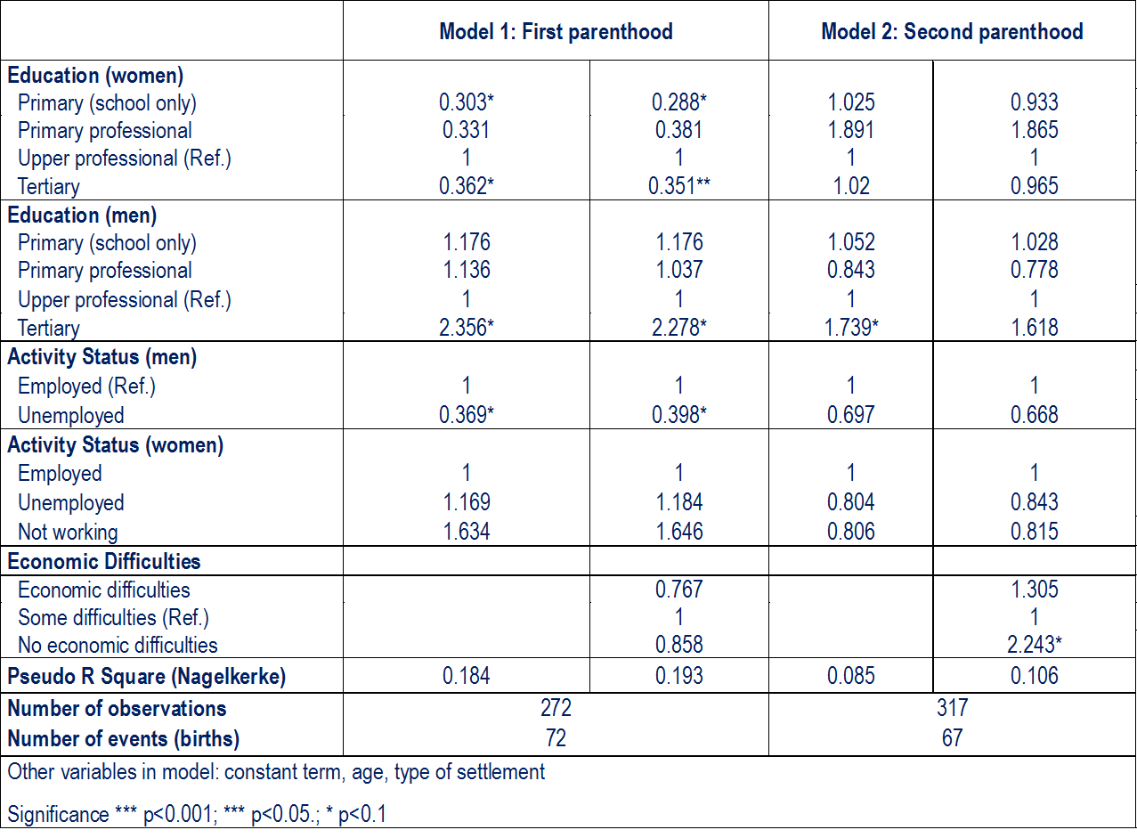
Realization of Birth Intentions

Slide 46
Realization of Birth Intentions
Do you intend to have a second child within the next 2 years?
Economic worries?
Second child realized?
?
2005 2007

Slide 47
Data: The German Family Panel

Slide 48
Data: German Family Panel
Name of Survey: German Family Panel
Interview Mode: Face-to-face, CAPI & CASI
Sample: Birth cohorts 1971-73, 1981-83, 1991-93
Sample Size: 13,000 (anchor) respondents
Type of Survey: Multi-Actor Panel Study
2008/09 2009/10 2010/11 2011/12 2012/13 2013/14 2014/15 2015/16 2016/17 2017/18

Slide 49
Data: German Family Panel
Multi-Actor
Anchor

Slide 50
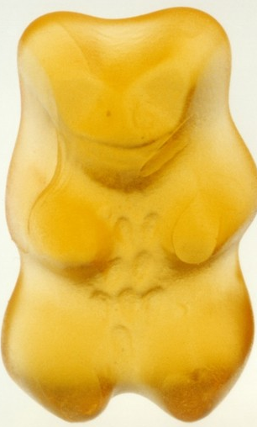
Data: German Family Panel
Multi-Actor
Anchor
Partner

Slide 51
Data: German Family Panel
Father
Mother
Multi-Actor
Anchor
Partner
Children of Anchor

Slide 52
Data: German Family Panel
Father
Mother
Multi-Actor
Anchor
Partner
Children of Anchor
2008/09 2009/10 2010/11 2011/12 2012/13 2013/14 2014/15 2015/16 2016/17 2017/18

Slide 53
Many thanks for your attention!

Slide 54
Fertility Desires
ID | YEAR | IDEAL Anchor
#1 | 2009 | 0
#1 | 2011 | 0
#1 | 2012 | 0
#1 | 2013 | 2
#1 | 2014 | 2

Slide 55
Fertility Desires
ID | YEAR | IDEAL Anchor | IDEAL Partner
#1 | 2009 | 0 | no partner
#1 | 2011 | 0 | no partner
#1 | 2012 | 0 | 2
#1 | 2013 | 2 | 2
#1 | 2014 | 2 | 2

Slide 56
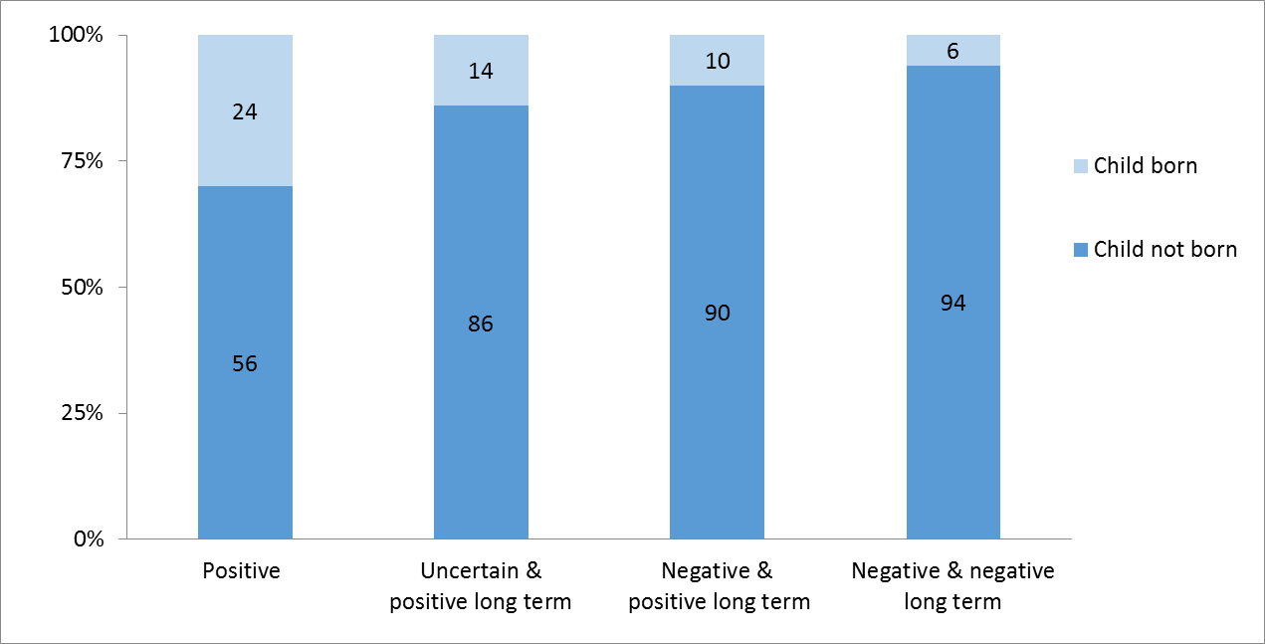
Realization of Birth Intentions
Realization of Birth Intentions between 2005 and 2007, Russia
Note:
Unlike Table 1, this figure contains all respondents, irrespective of whether they were partnered in wave1.
Positive indicates that the respondent had positive intentions to have a(nother) child within the next three years in wave 1.
Uncertain & positive long term indicates that the respondent was uncertain to have a(nother) child within the next three years. but in general plans to have a(nother ) child.
Negative & positive long term indicates that the respondent did not want a(nother) child within the next three years in wave 1. but in general plans to have a(nother ) child.
Negative & negative long term indicates that the respondent did not want a(nother) child within the next three years and generally does not want any (further) children.
Source: Russian GGS 1 and 2 waves; own calculations.
Source: GGS, weigthed estimates

