Slide 1
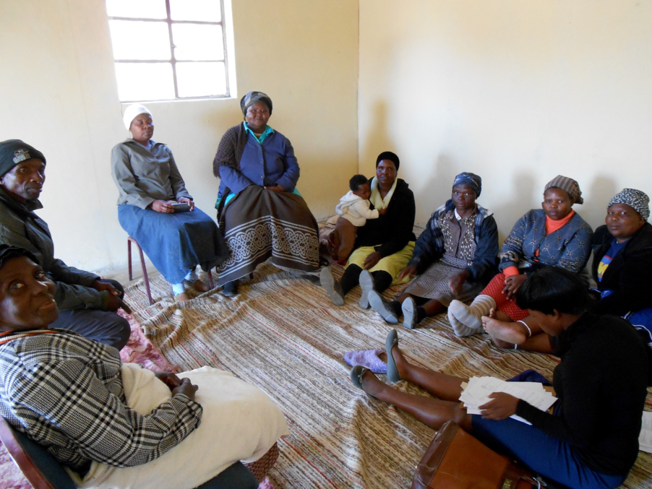
Paying your way: Non-profit paths to sustainability
HSE Young Professionals' Workshop
May 2015
Notes:
Format:
talk of around 90 minutes (plus discussion).
The audience will comprise of Master and Doctoral students in Sociology as well as Faculty members and perhaps also some undergraduate students.

Slide 2
SaveAct
Background: Founded in 2005 in South Africa with the mission to respond to poverty in rural areas
The SaveAct Model: relies on community based promoters to train and manage saving and credit groups
Funding: established with donor-funding and remains donor-based
The Three Pillars of SaveAct’s model
Enterprise development
Financial education & life skills training
Savings and credit
Number of SCGs: 1 916
Total membership: 38 355
90% female
Present in 4 provinces

Slide 3
SaveAct’s challenges
Increased demand for services from local communities
1
Mission
Donors willing to pay for expansion, but not for core operations
Sustainability issues
2
Capital Structure
Organisational Capacity
Rapid growth in a short space of time
3

Slide 4
There are a number of potential solutions…
Fee for service model
Charge group members a fee for training and group membership
Cross-subsidisation through social enterprise
Utilise the group network to distribute products such as solar lamps
Amend the model
Transform into an MFI where interest payments fund operating costs
Focus on fundraising
Source additional donors to sustain the organisation

